Slide 1
Report: the Academic Day of the University
Serbia – Belgrade, 11.06.2011.
Faculty of Philosophy

Slide 2
Basic information
63 participants – 52 valid questionnaires
Time: Saturday, 11.06.2011.
10.00 h – 15.30 h, with breaks
Rooms: amphitheater + classrooms
Resources in workshops and lectures: printed material, pictures and presentations showed on projector, cubes from Viminacium, drawings of participants
Documentation: photos
Students – volunteers

Slide 3
Conception
Part I:
Word of welcome
Introduction to the DASUN project
Introduction of partner (NGO) organizations
Lectures
Part II:
Workshops
Evaluation – questionnaire

Slide 4
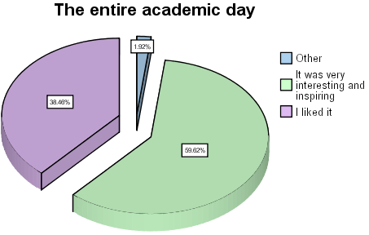
General impression of the first Academic day

Slide 5
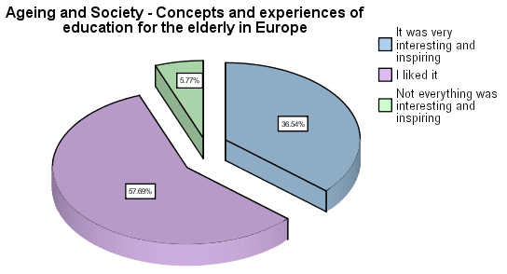
Lectures
“Ageing and Society - Concepts and experiences of education for the elderly in Europe”

Slide 6
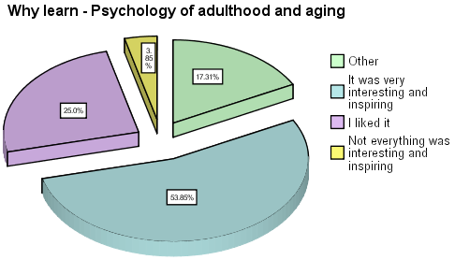
Lectures
“Why learn - Psychology of adulthood and aging”

Slide 7
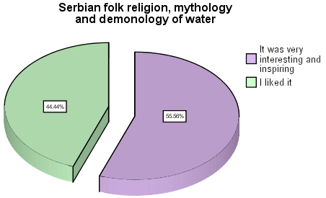
Workshops
Ethnology and anthropology: “Serbian folk religion, mythology and demonology of water”

Slide 8
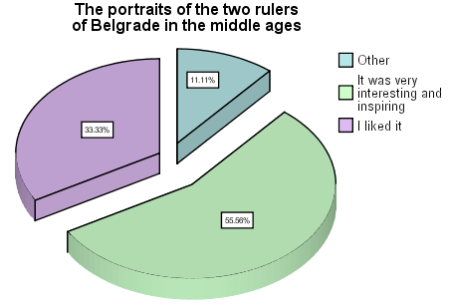
Workshops
Art history: “The portraits of the two rulers of Belgrade in the middle ages”

Slide 9
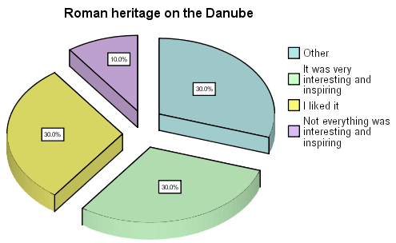
Workshops
Archeology : “Roman heritage on the Danube”

Slide 10
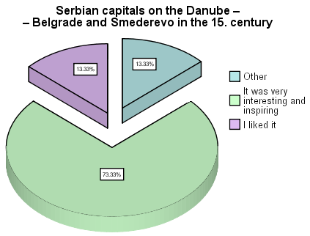
Workshops
History : “Serbian capitals on the Danube – Belgrade and Smederevo in the 15. century”

Slide 11
Suggestions
To inform people about the project – media and associations/organizations of pensioners
To organize the Academic days/week
To organize it more often
To organize workshops at different time
To expand it to other faculties of University of Belgrade and their scientific fields

Slide 12
Scientific fields of other faculties of University of Belgrade
Economy | Astronomy
Faculty of Organizational Sciences | Genetics
Geography | Fine arts
Agronomy | Film art
Computers | Biology
Banking Services | Music and Ethno music
Literature and Language Studies | Legal sciences
History of science | Architecture
Medicine and Health | Faculty of Security

Slide 13
Dissemination of
Radio Belgrade 1 – two shows
Television Studio B – morning programm
National Television – RTS 1 – show about modern trends in education
Newspapers Healthy Life
Flyers
Posters in buses
!!! Impressions of participants !!!

Slide 14
SWOT analysis
trength
Space for realization
Professional staff
Experience
Diversity of content
New ideas

Slide 15
SWOT analysis
eaknesses
Different organizations involved – organizing activities and distributing tasks
No team, at this moment

Slide 16
SWOT analysis
pportunities
Interest of future participants
Contact with media
Intergenerational cooperation
Cooperation with countries from Danube region
Sponsorship
Law – Adult Education Act

Slide 17
SWOT analysis
hreats
Financing
Lack of cooperation within the civil sector

Slide 18
Future plans
Forming a team, especially person who works with organization and coordination
Financing
Meeting with representatives of other faculties of the University
Brochures and promo-materials

