Slide 1
GIFT OF THE HEART
Heinz Kubicka

Slide 2
It everything happen during and after Grundtvig Partner Meeting in Slupsk, in October 2011.

Slide 3
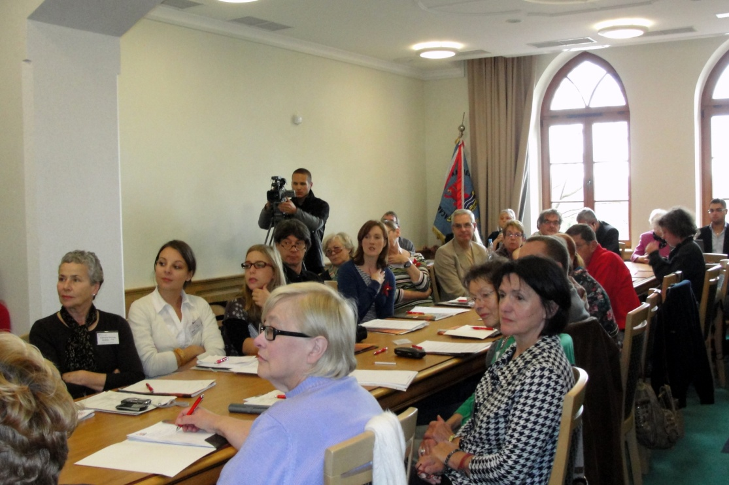
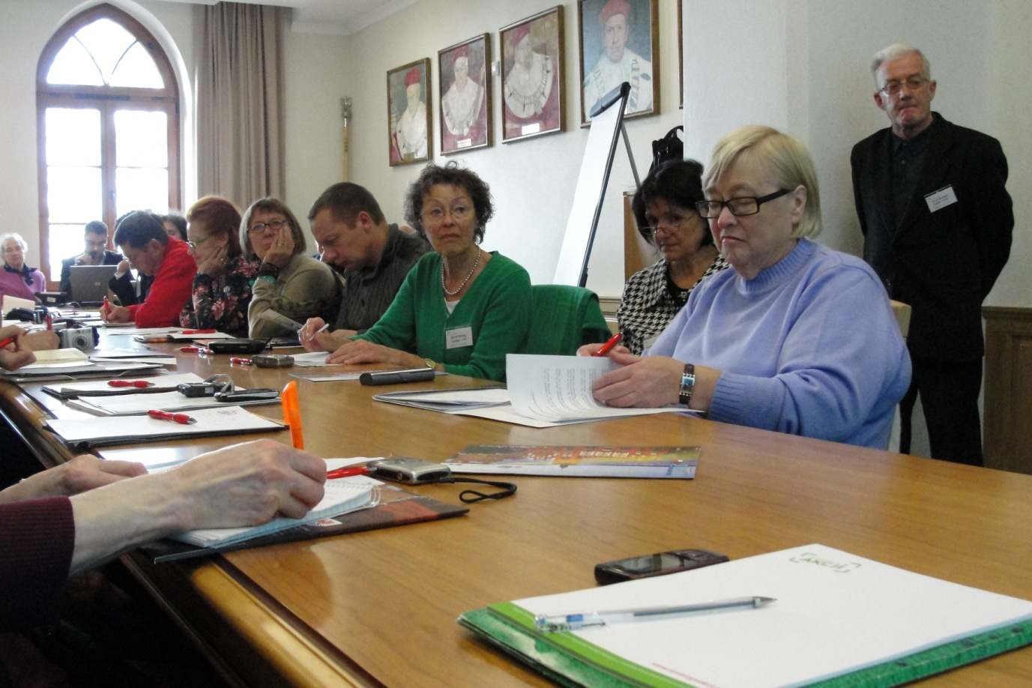
The Project Partners had arrived to Slupsk in order to review the progress of the „Tell me about your commitment” Project.

Slide 4
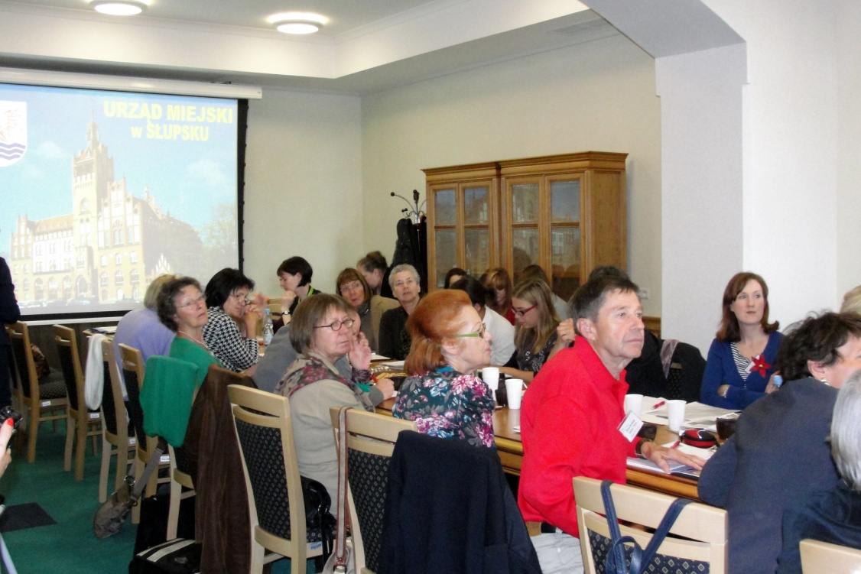
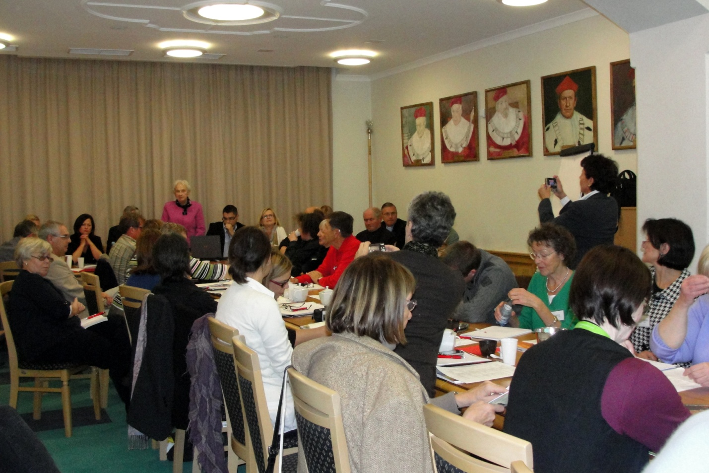
In among the Vienna group there was Mr Heinz Kubicka

Slide 5
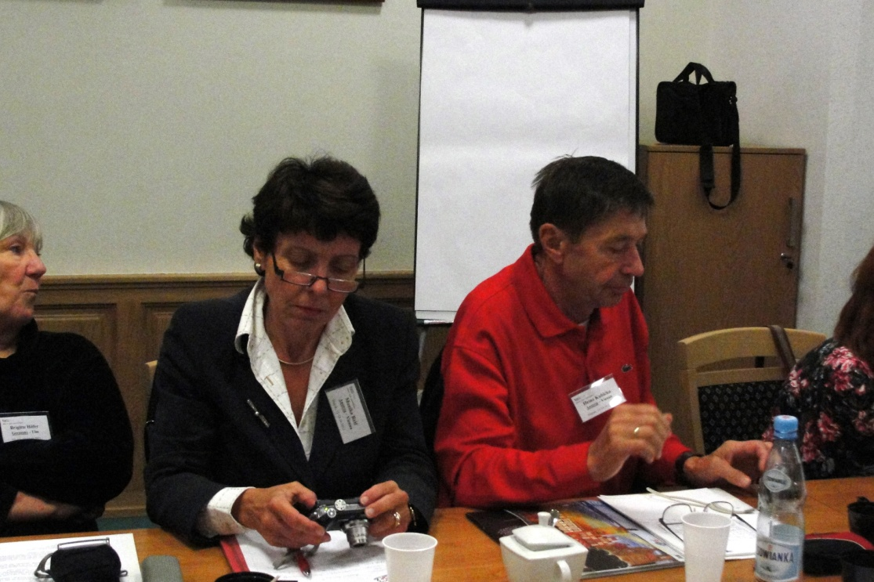
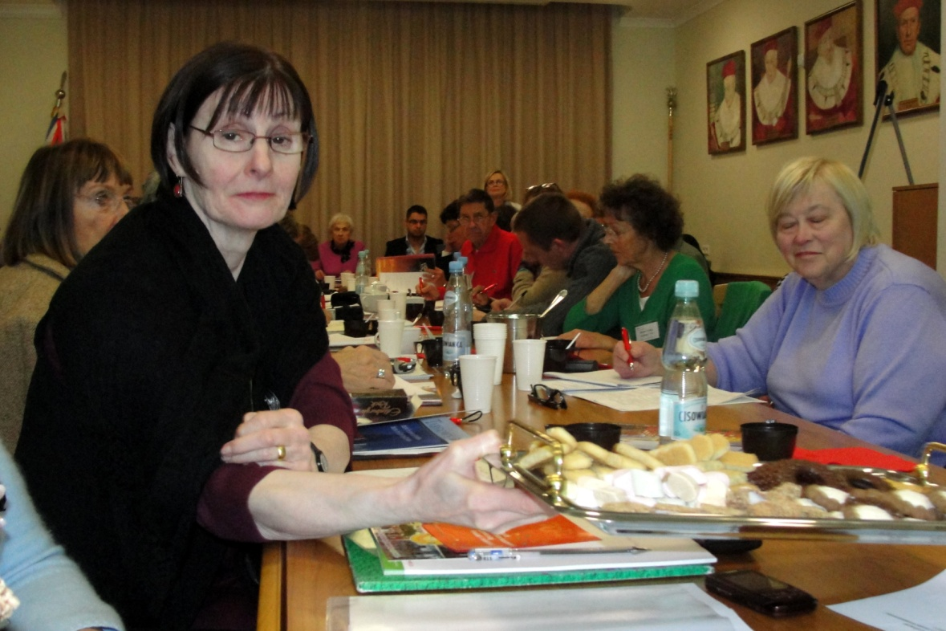
Here you can see him working during workshop time along with his colleagues

Slide 6
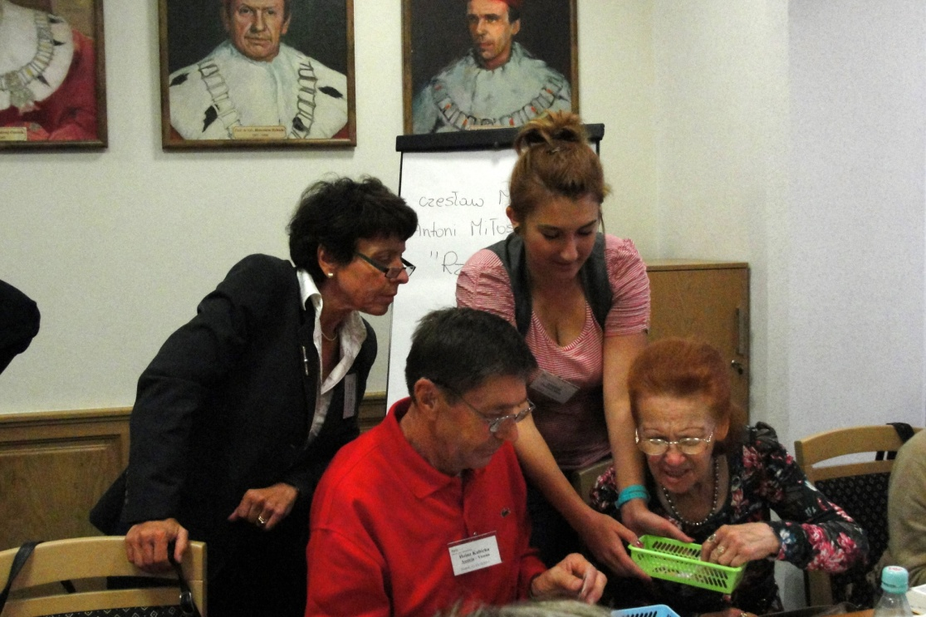
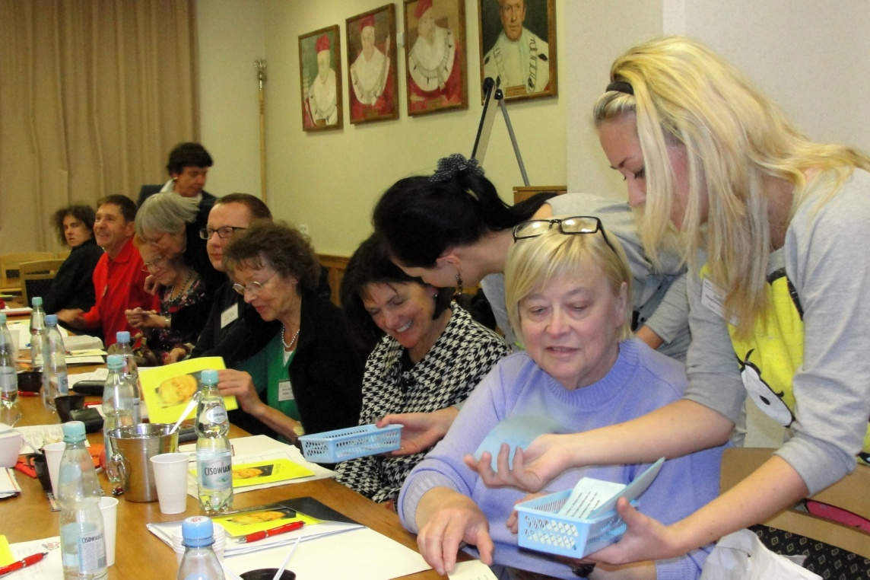
The difficult task had been explained to all the participants

Slide 7
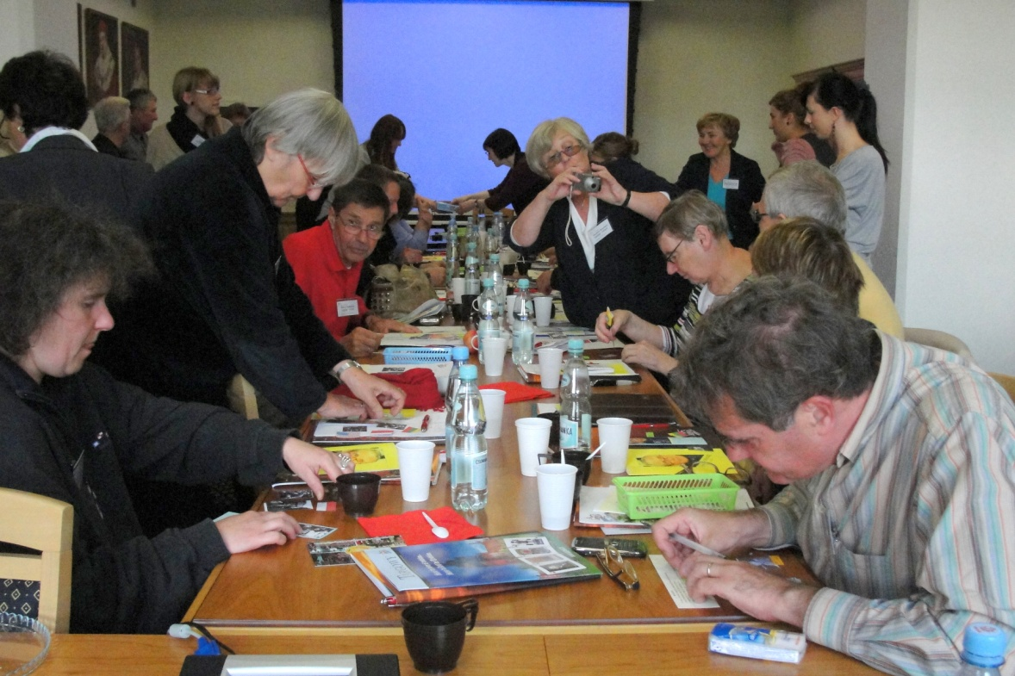
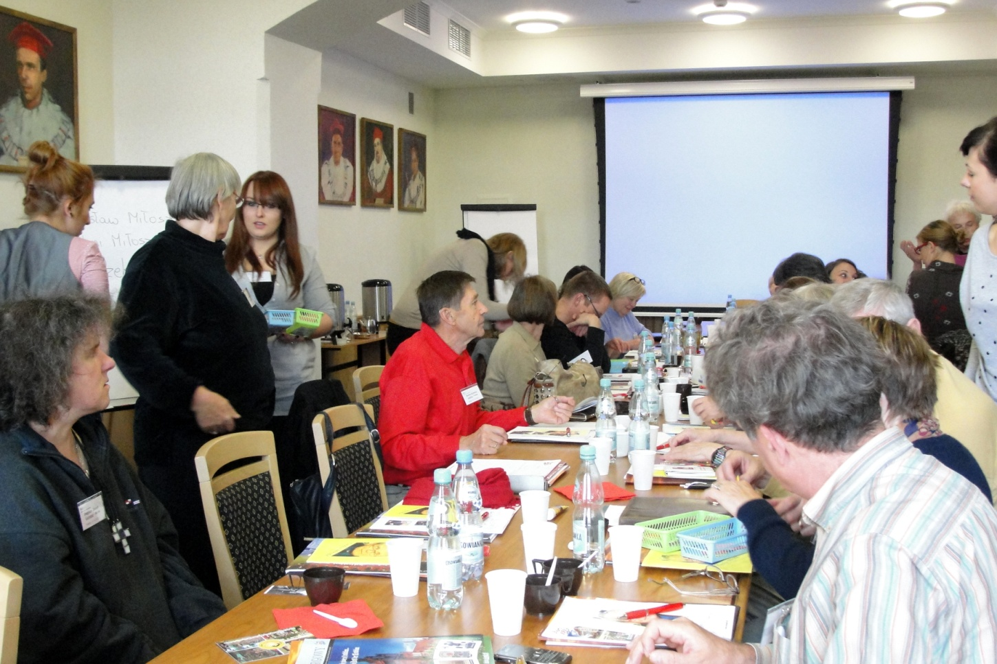
All seemed to be deeply involved..

Slide 8
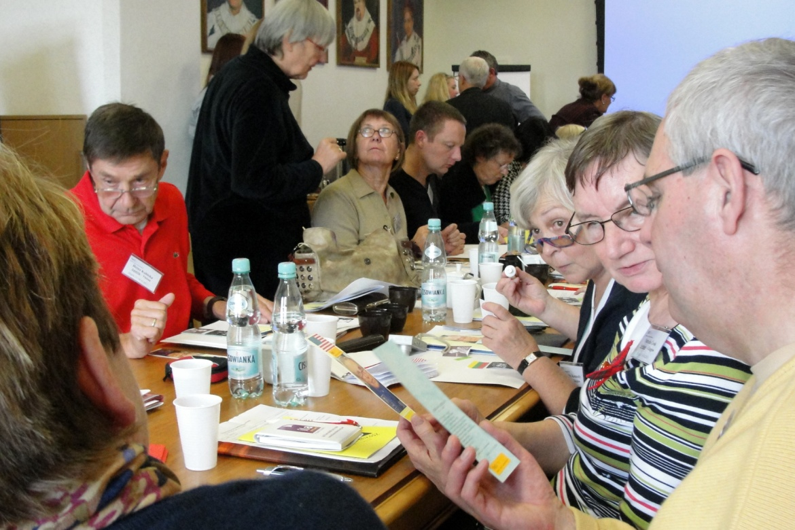
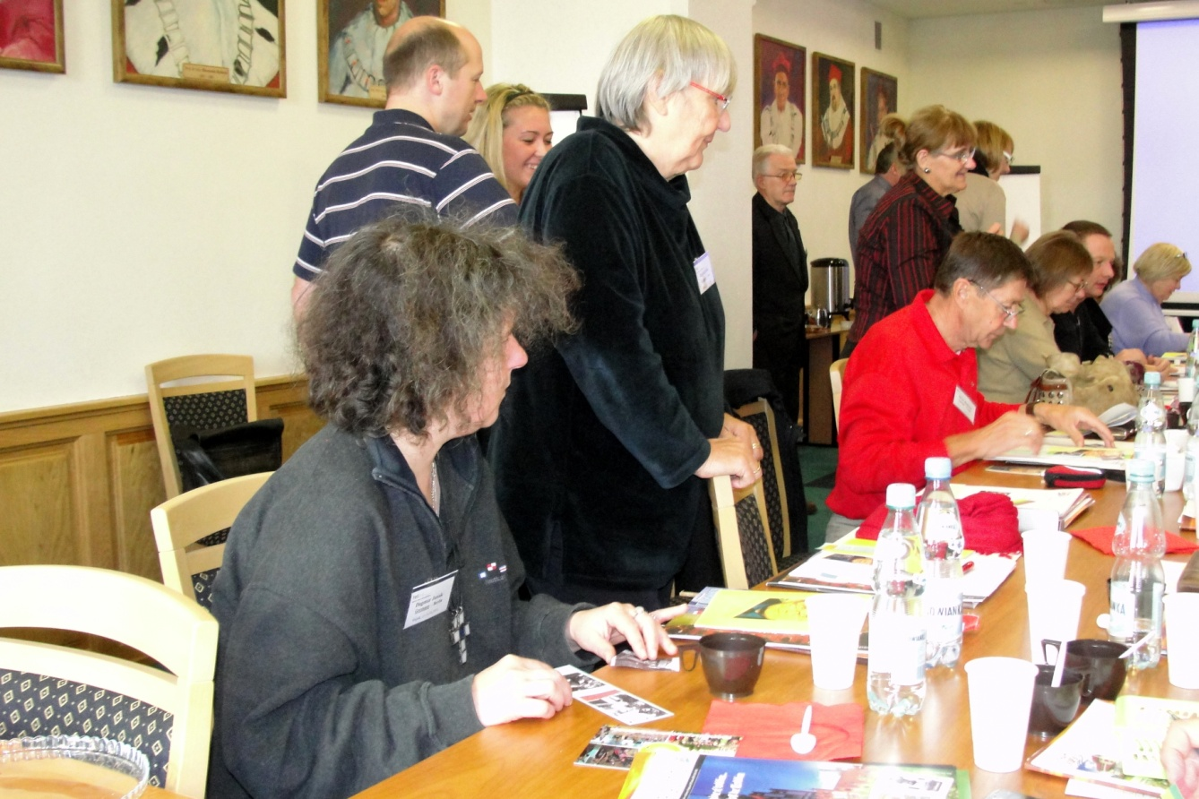
The task was to work out a bookmark with the leading theme on great Polish poet Czeslaw Milosz and his poetry.

Slide 9
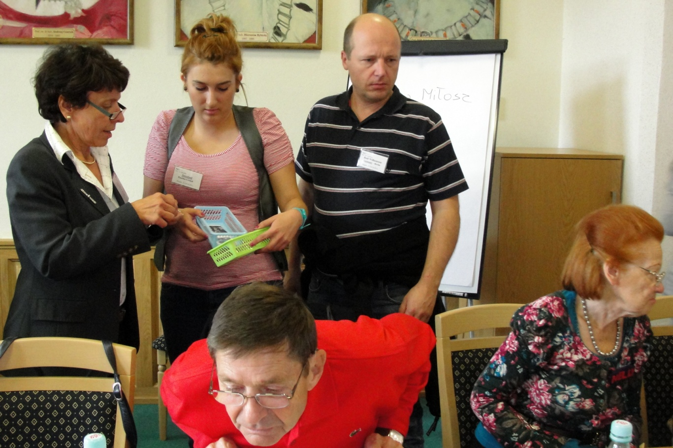
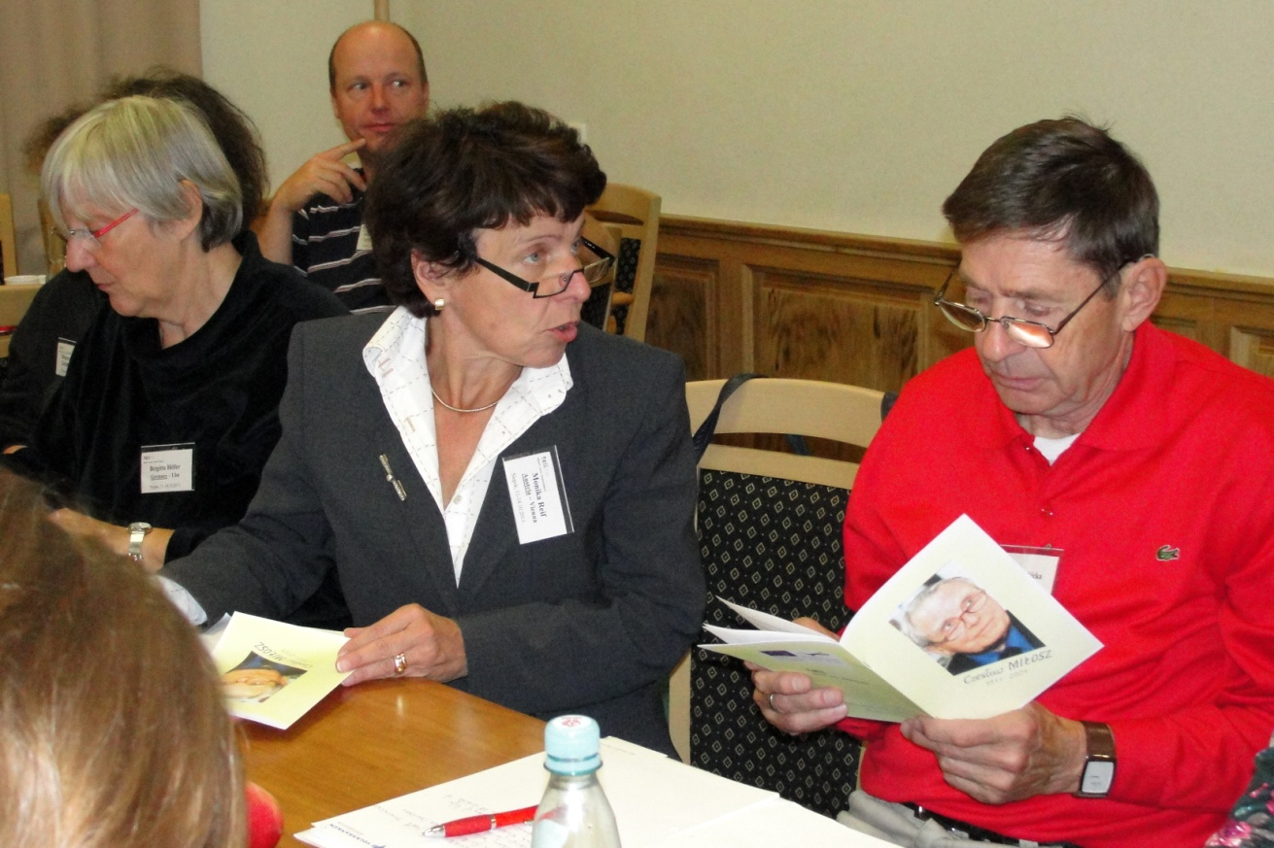
The task almost completed..

Slide 10
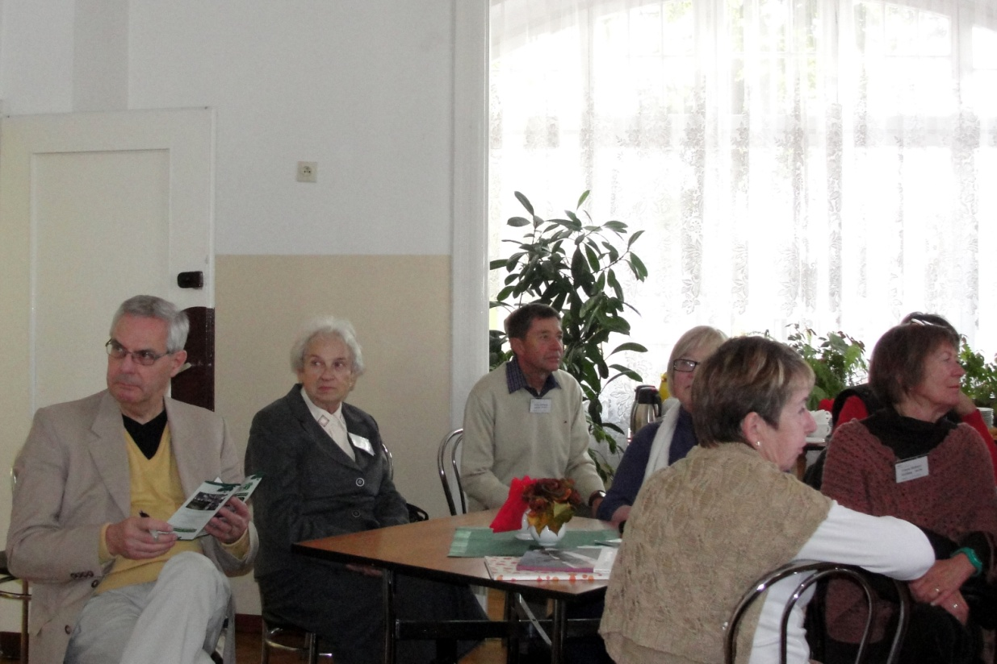
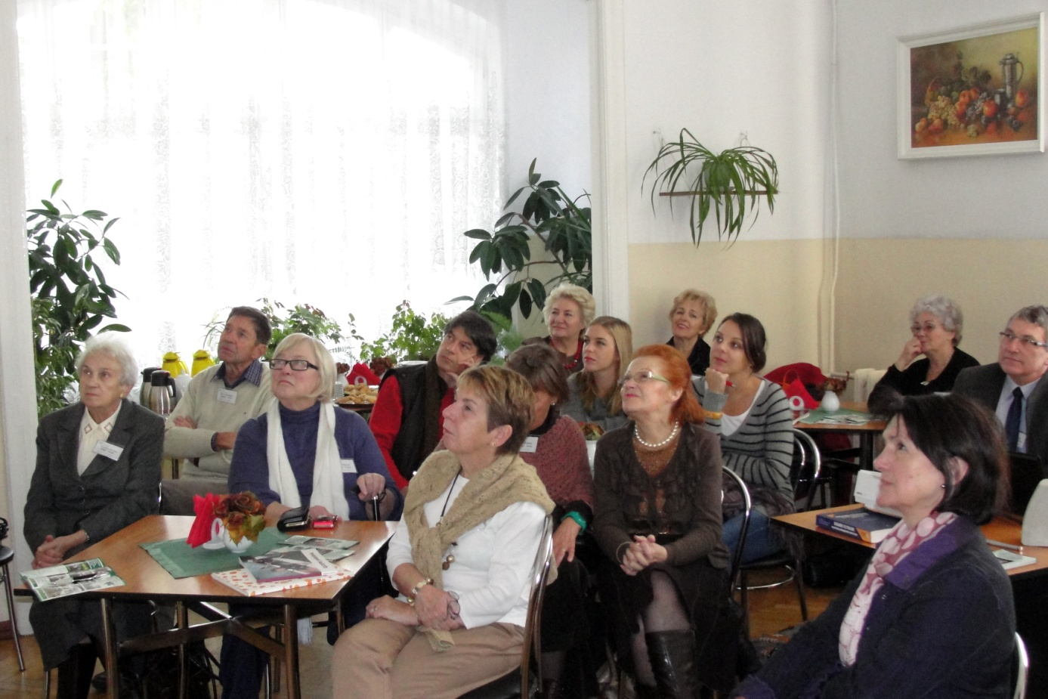
All partner during the visit to the Daily Care Home in Slupsk.

Slide 11
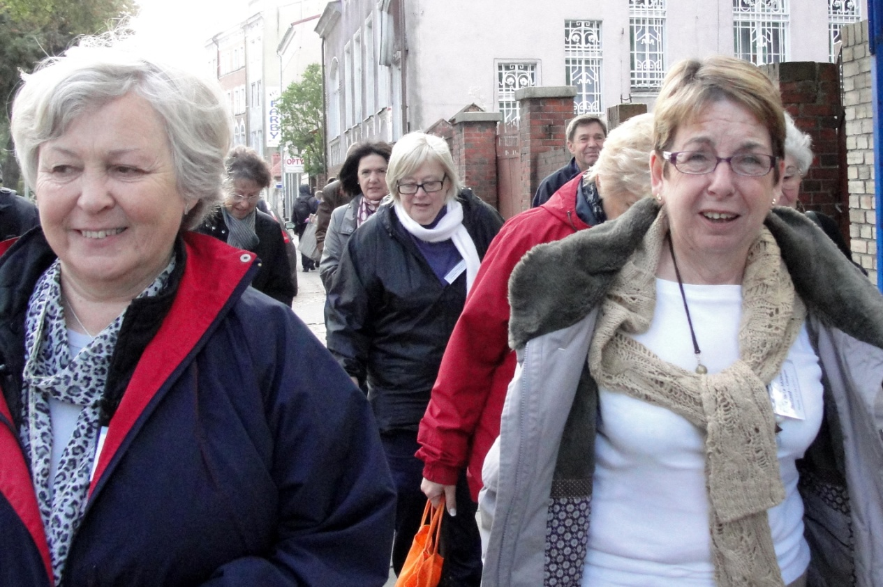
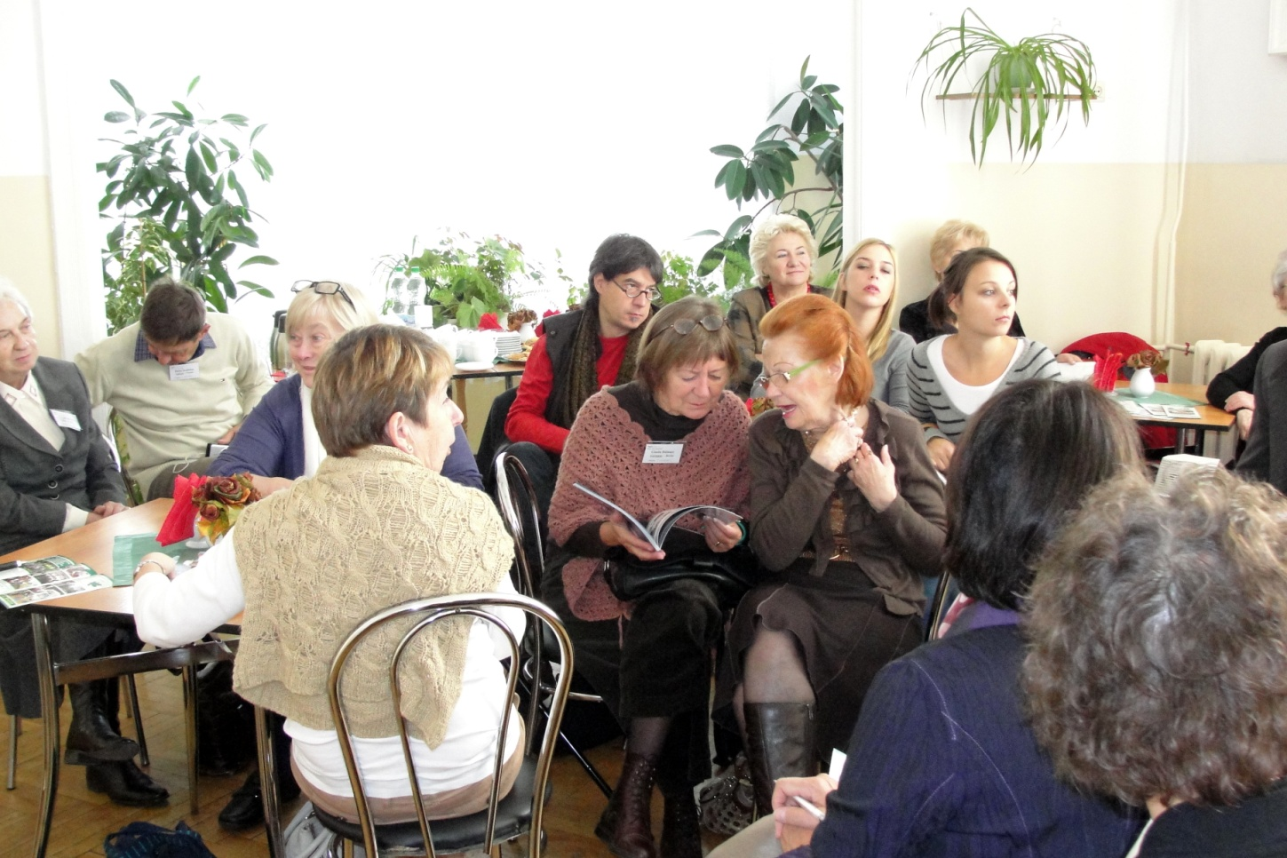
Getting around..

Slide 12
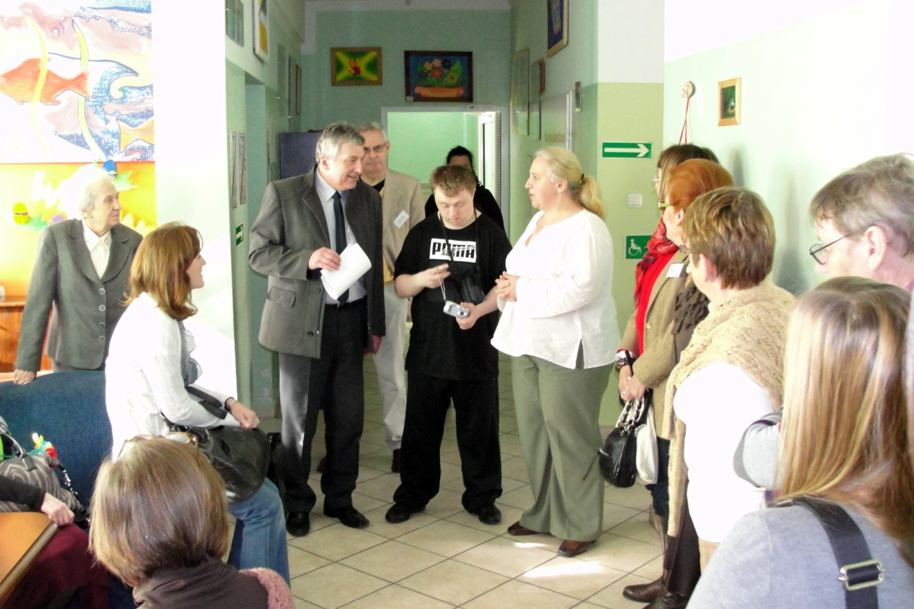
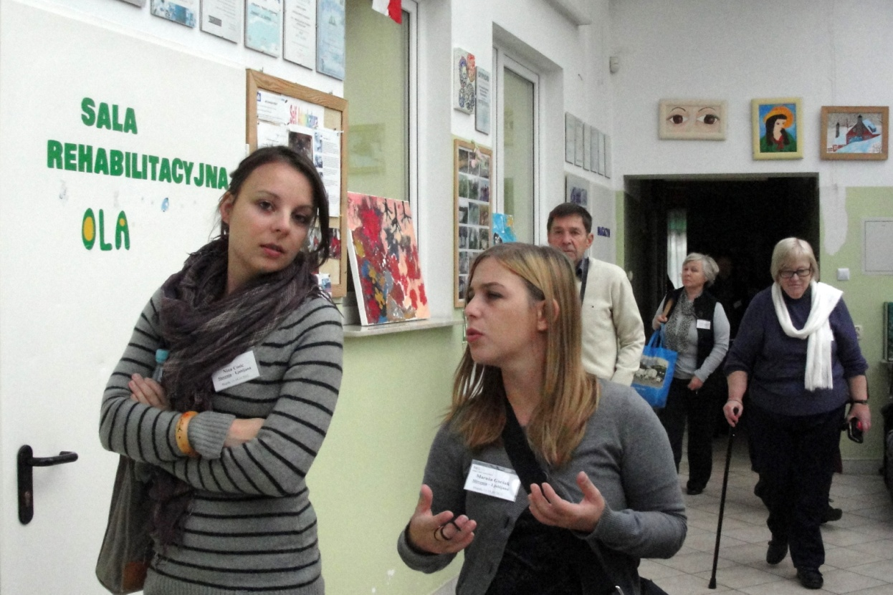
The guests visit to the Occupational Therapy Workshop in Slupsk.Mrs Iwona Grota explaining the work She oversees.

Slide 13
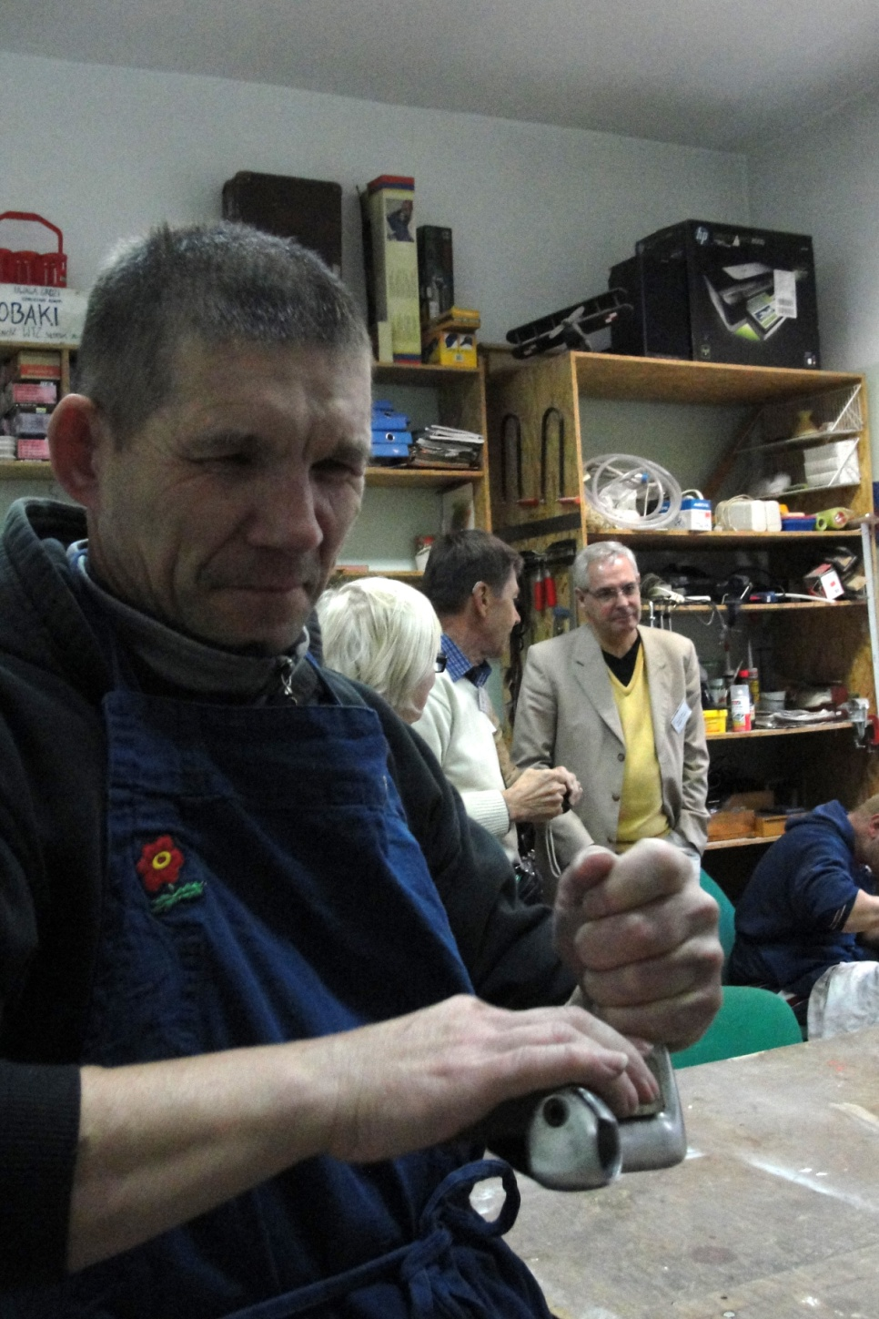
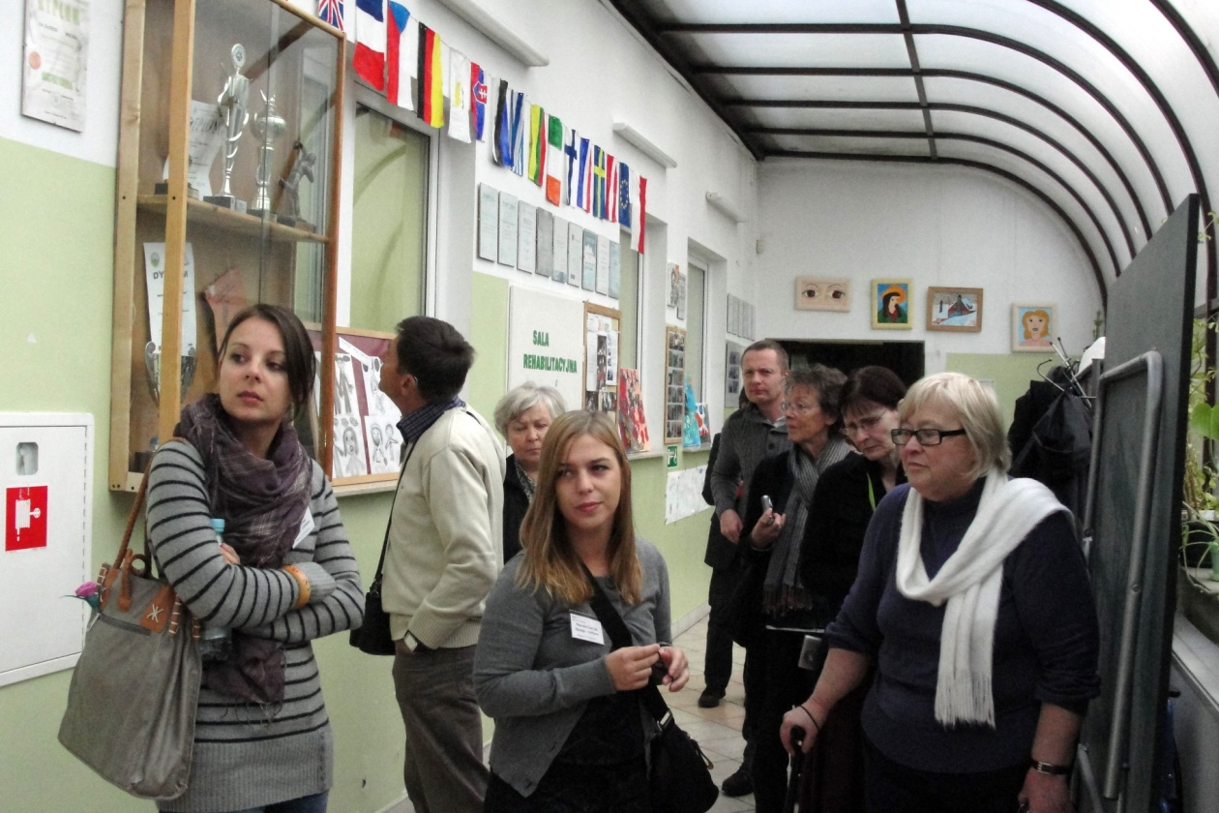
The quests were allowed to visit all the premises of the Institution

Slide 14
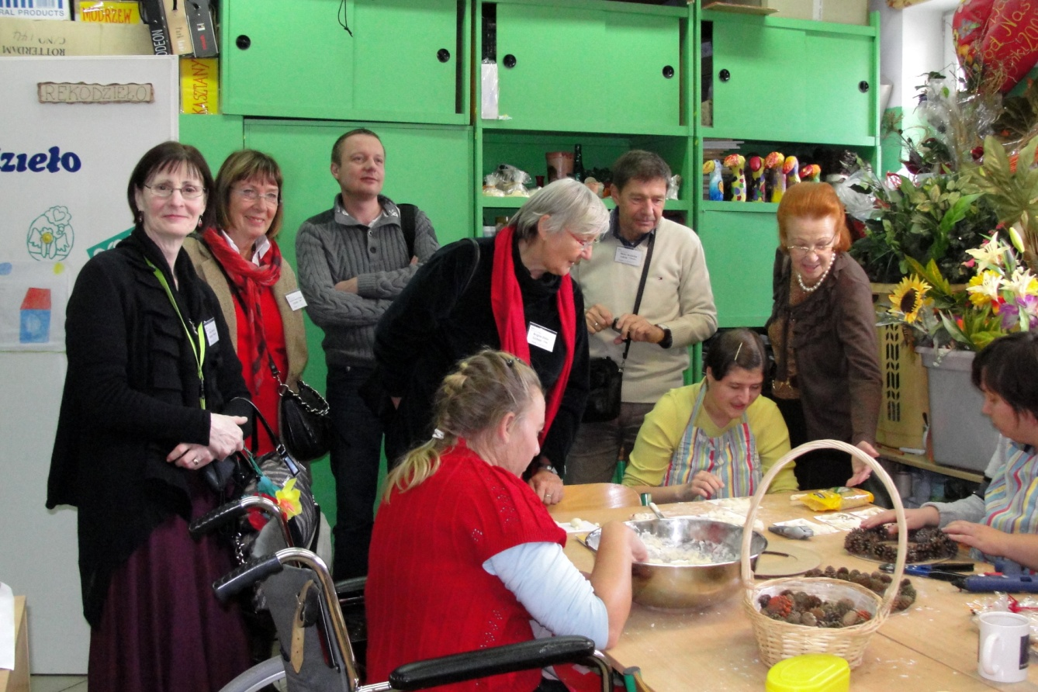
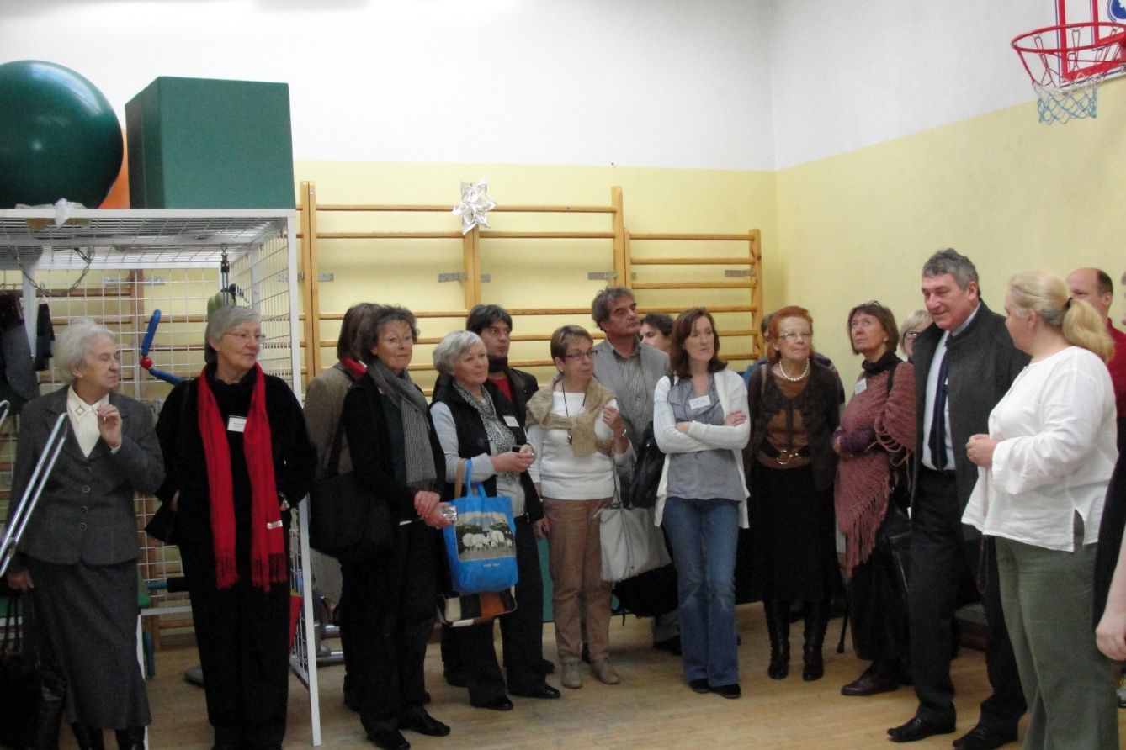
During the visit the detailed information was presented

Slide 15
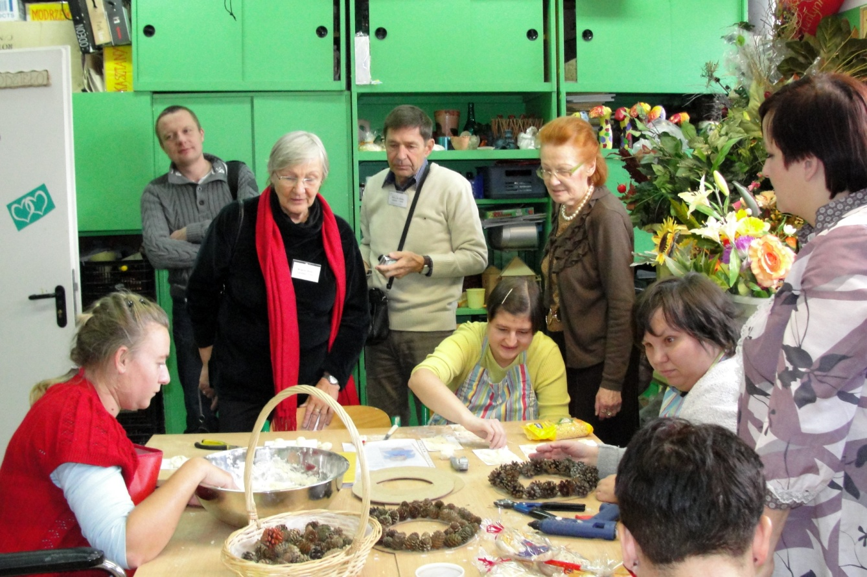
The pieces of hand works of different kinds were on show..

Slide 16
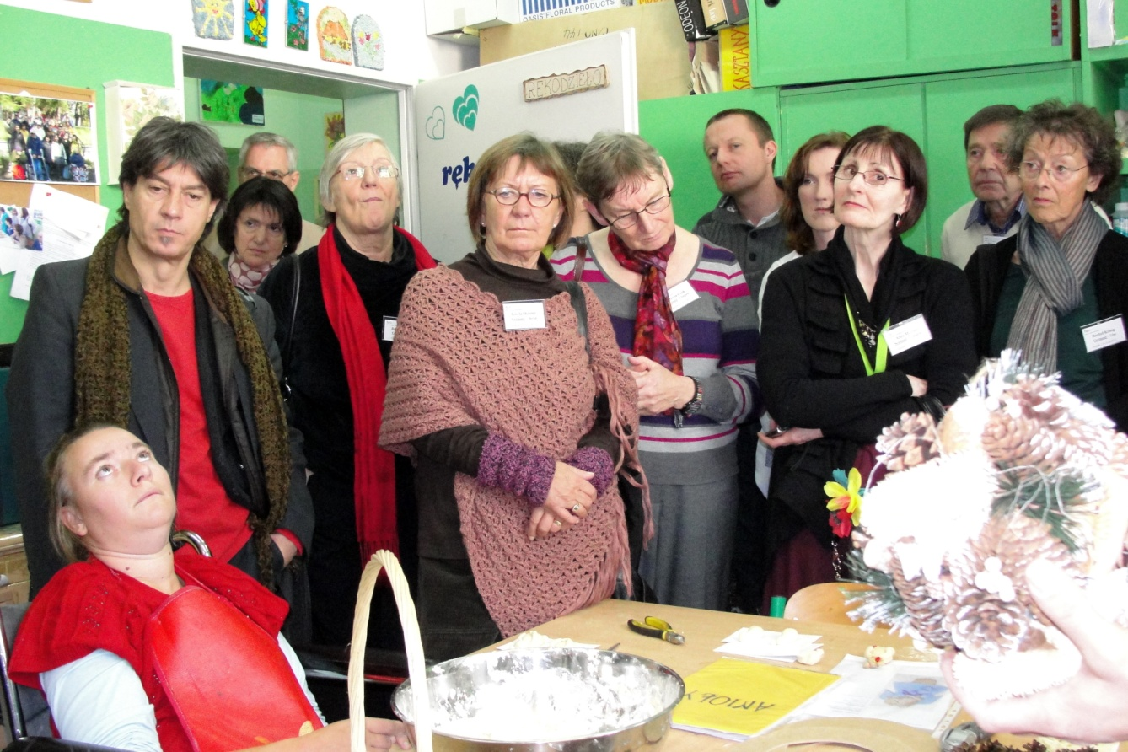
The picture taken during the visit…

Slide 17
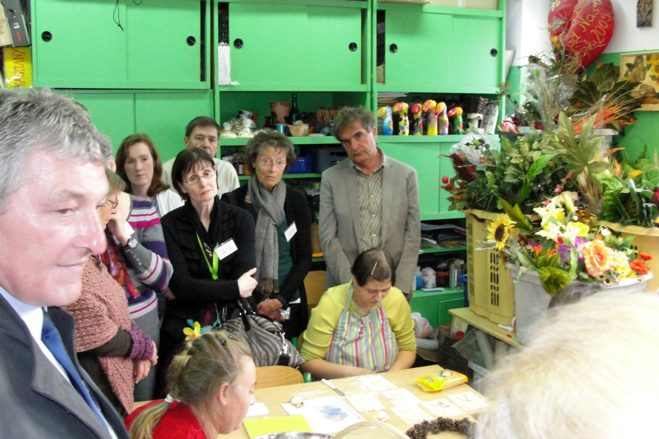
One more picture taken…

Slide 18
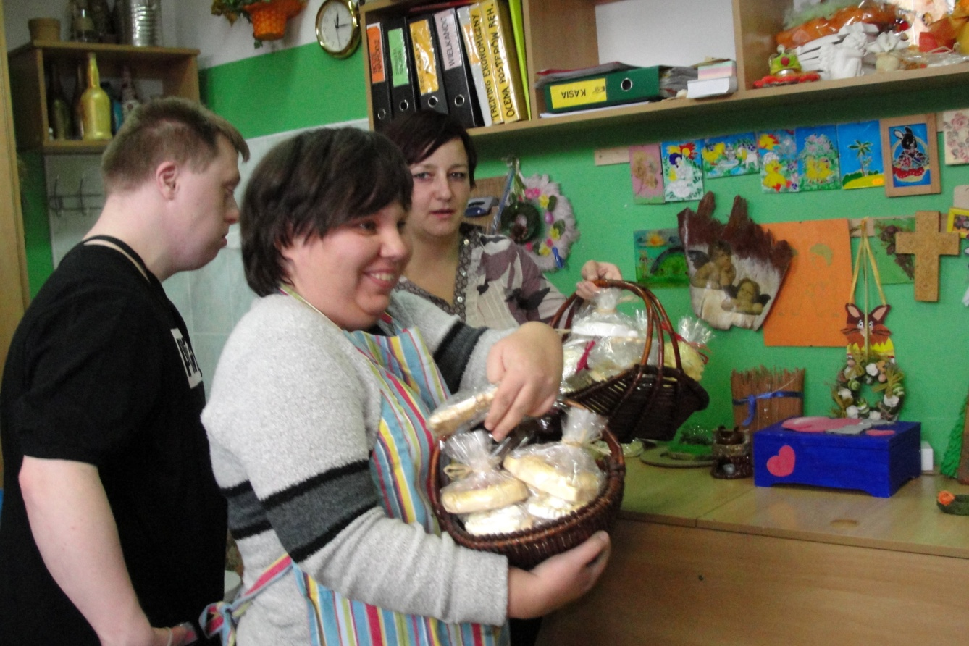
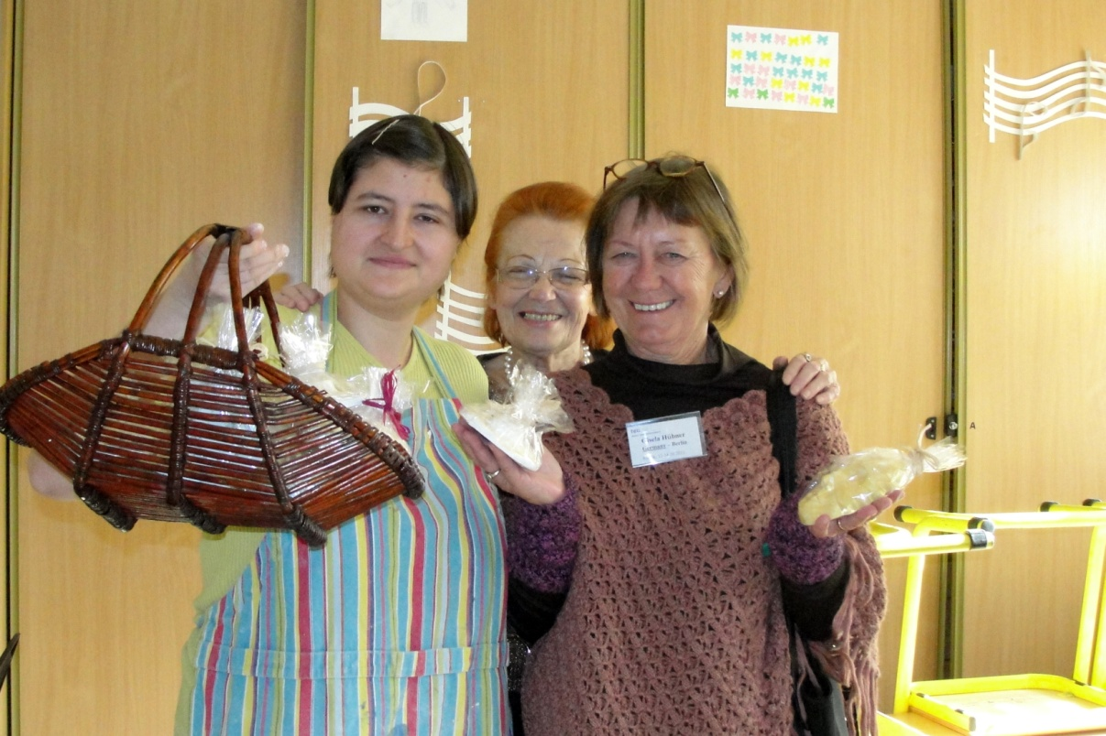
The visitors were treated with hand
Made presents…

Slide 19
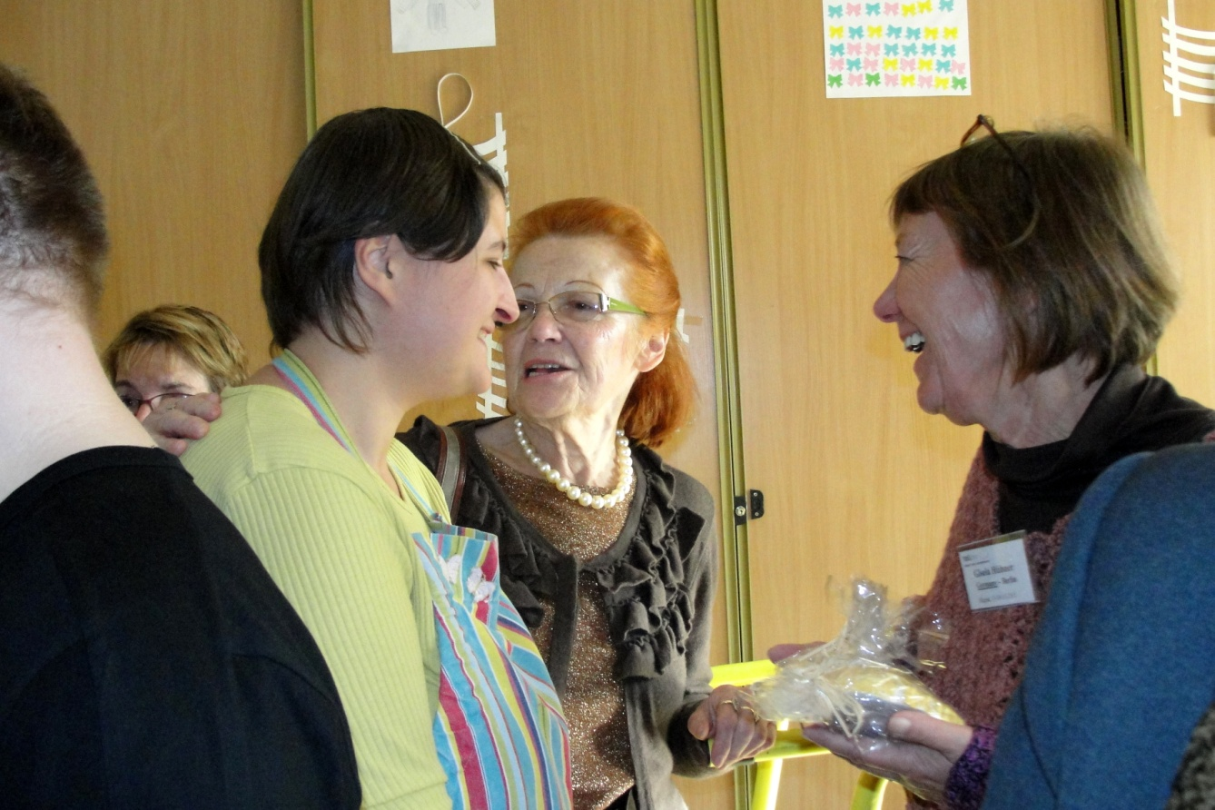
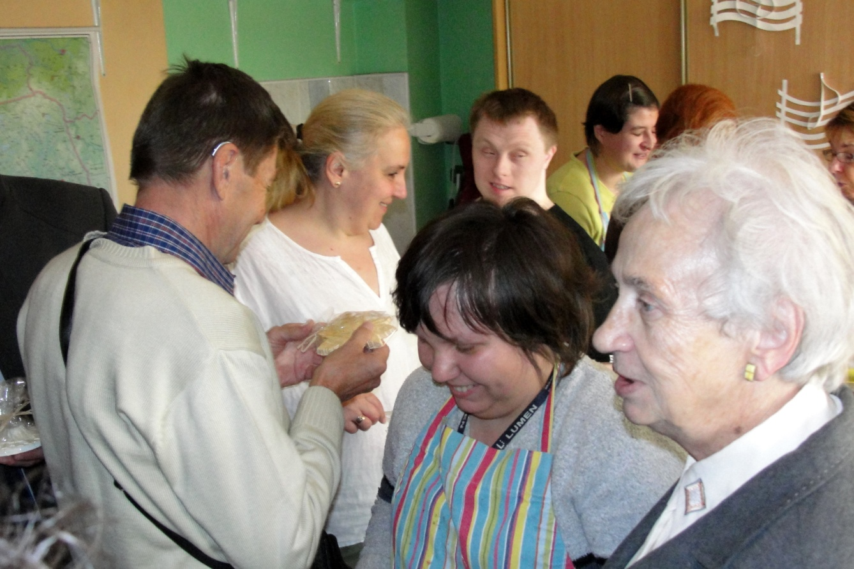

Slide 20
And it was only during this visit when the „Gift of the Heart” story begins. On returning back home from his trip to Slupsk we were sent a letter from Vienna with unexpected and very kind offer
of a donation aimed for Occupational Therapy Workshop.
Mrs Iwona Grota-the head of the Institution had welcomed the donation of around 1000€ which had been spent to improve their kitchen equipment
The importance of the new equipment is with its role in the process of rehabilitation and self-support training of the patients.
The donation made by Mr Heinz Kubicka had been collected among members of the Ewangelical Church in Vienna.

Slide 21
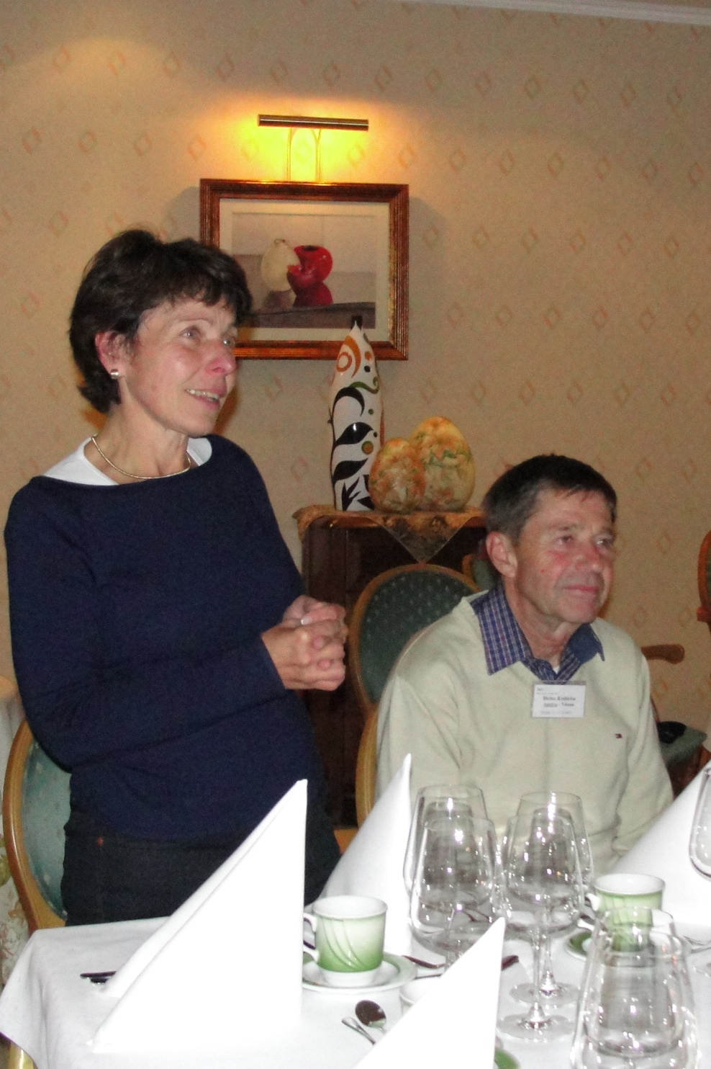
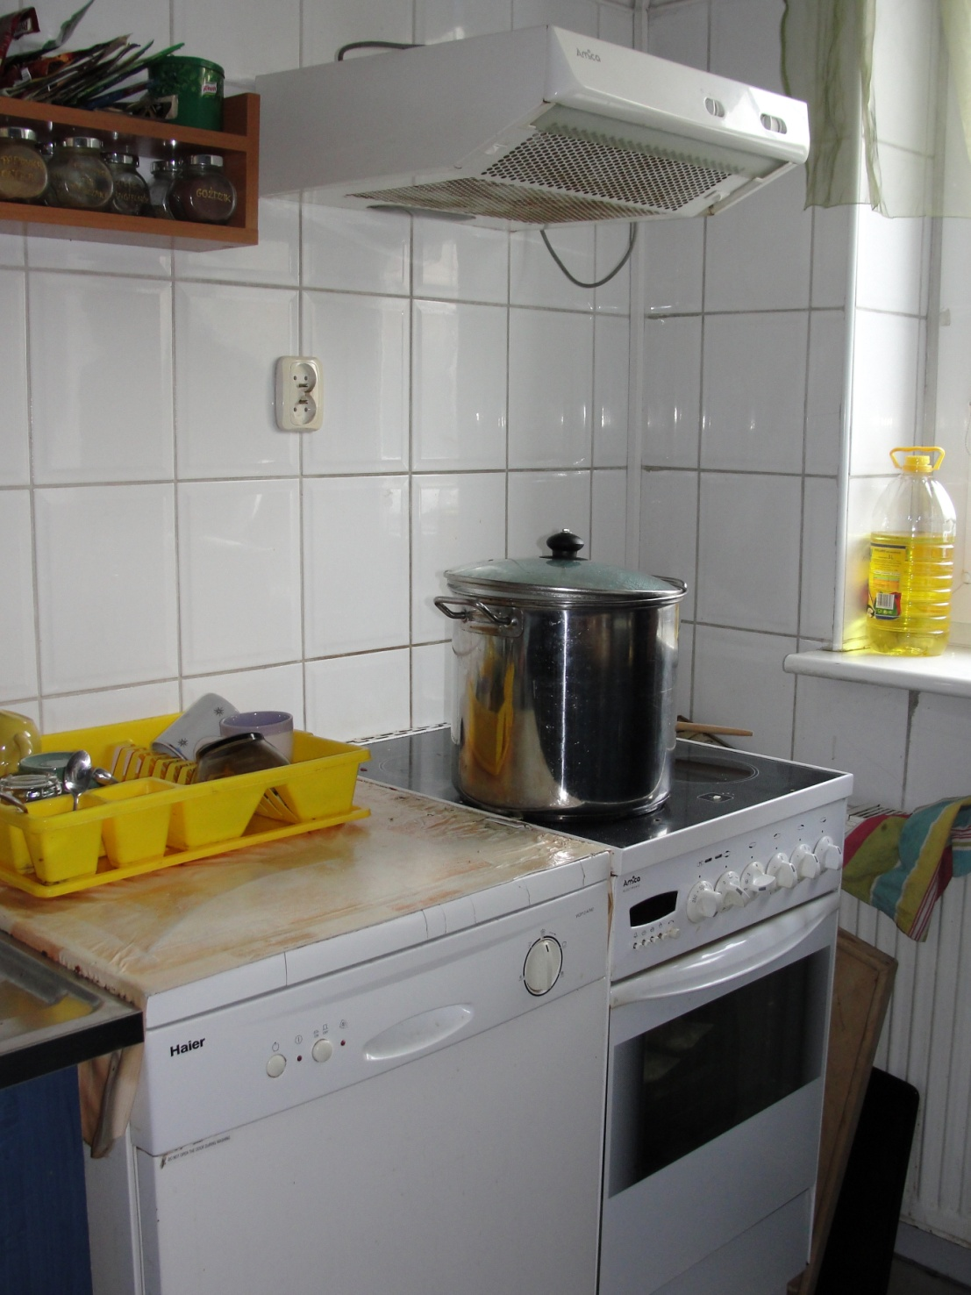

Slide 22
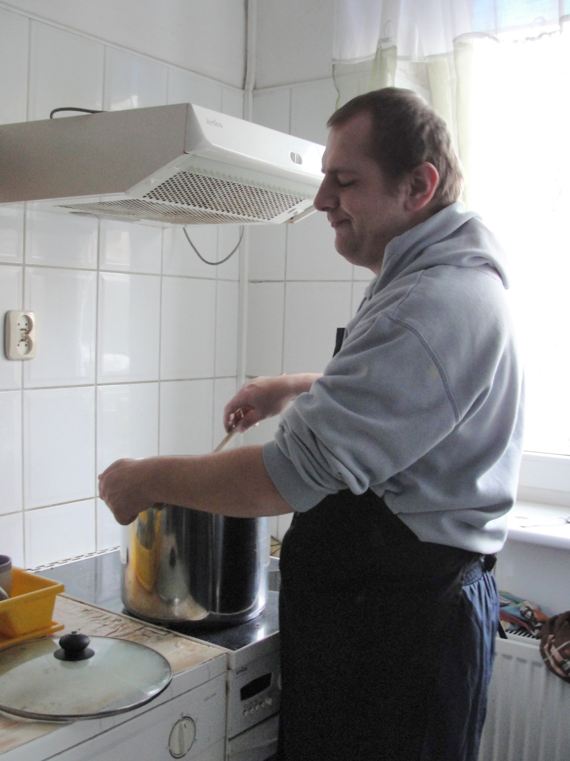
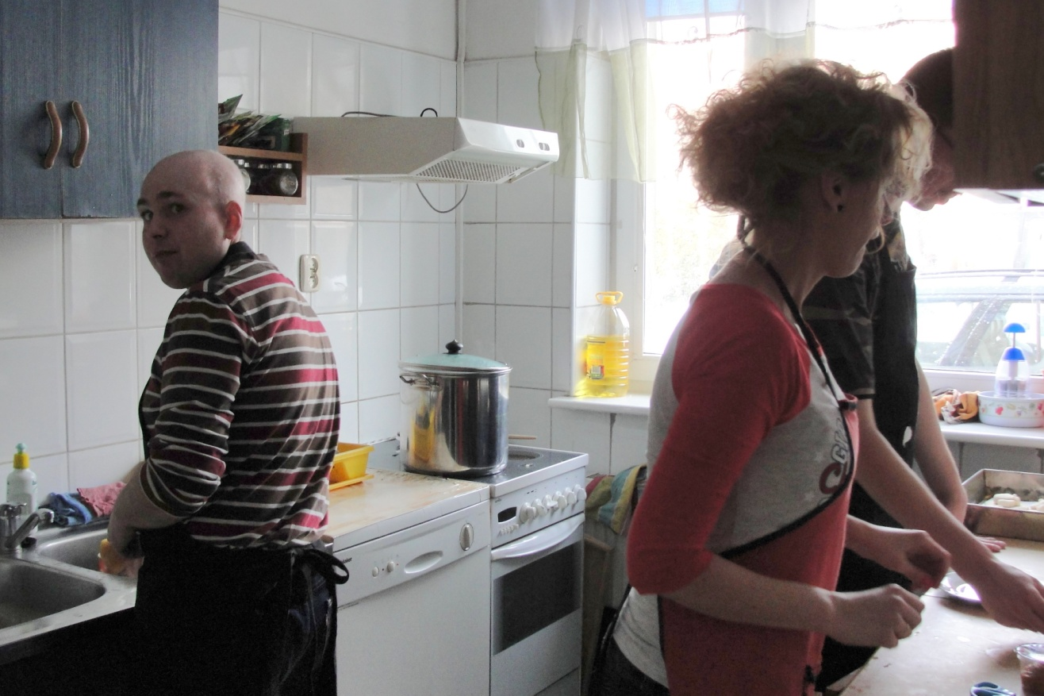
The new equipment in place and working…

Slide 23
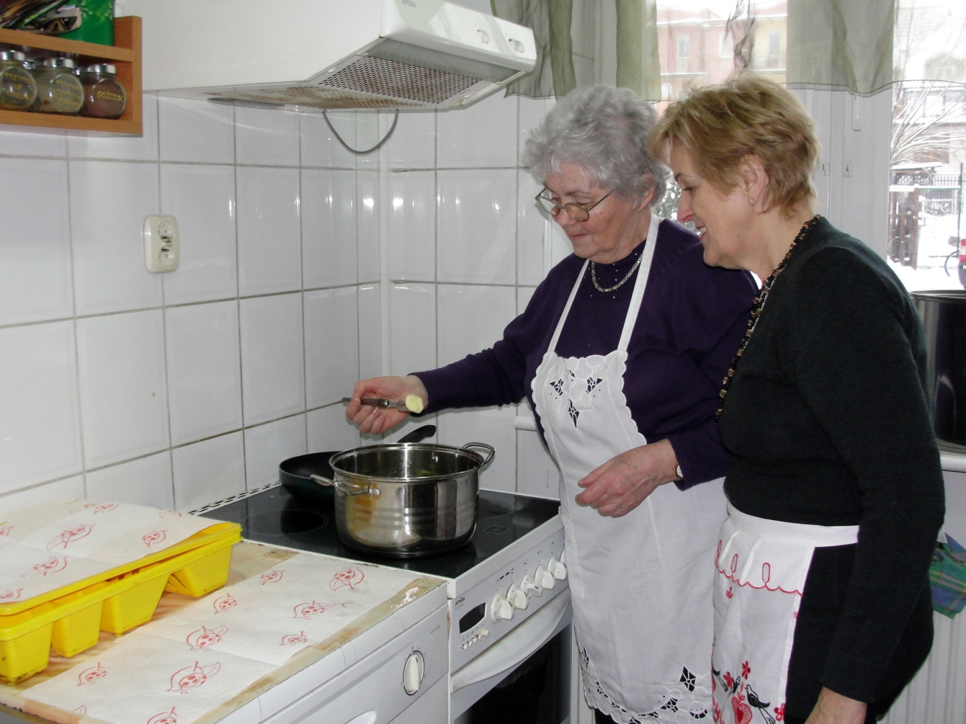
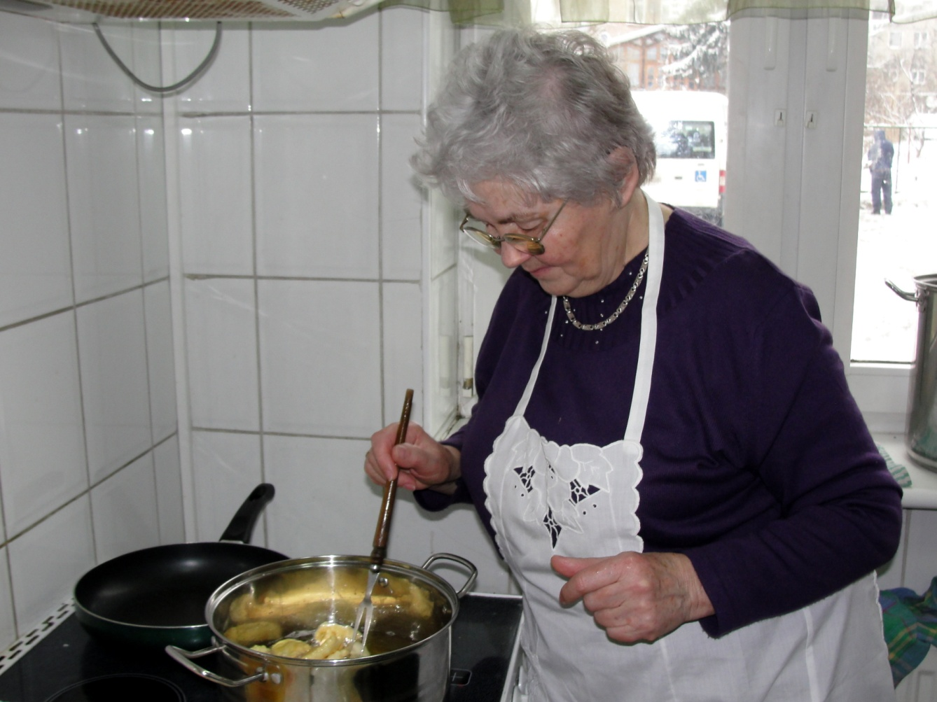
Members of the SUTW assisting and helping…

Slide 24
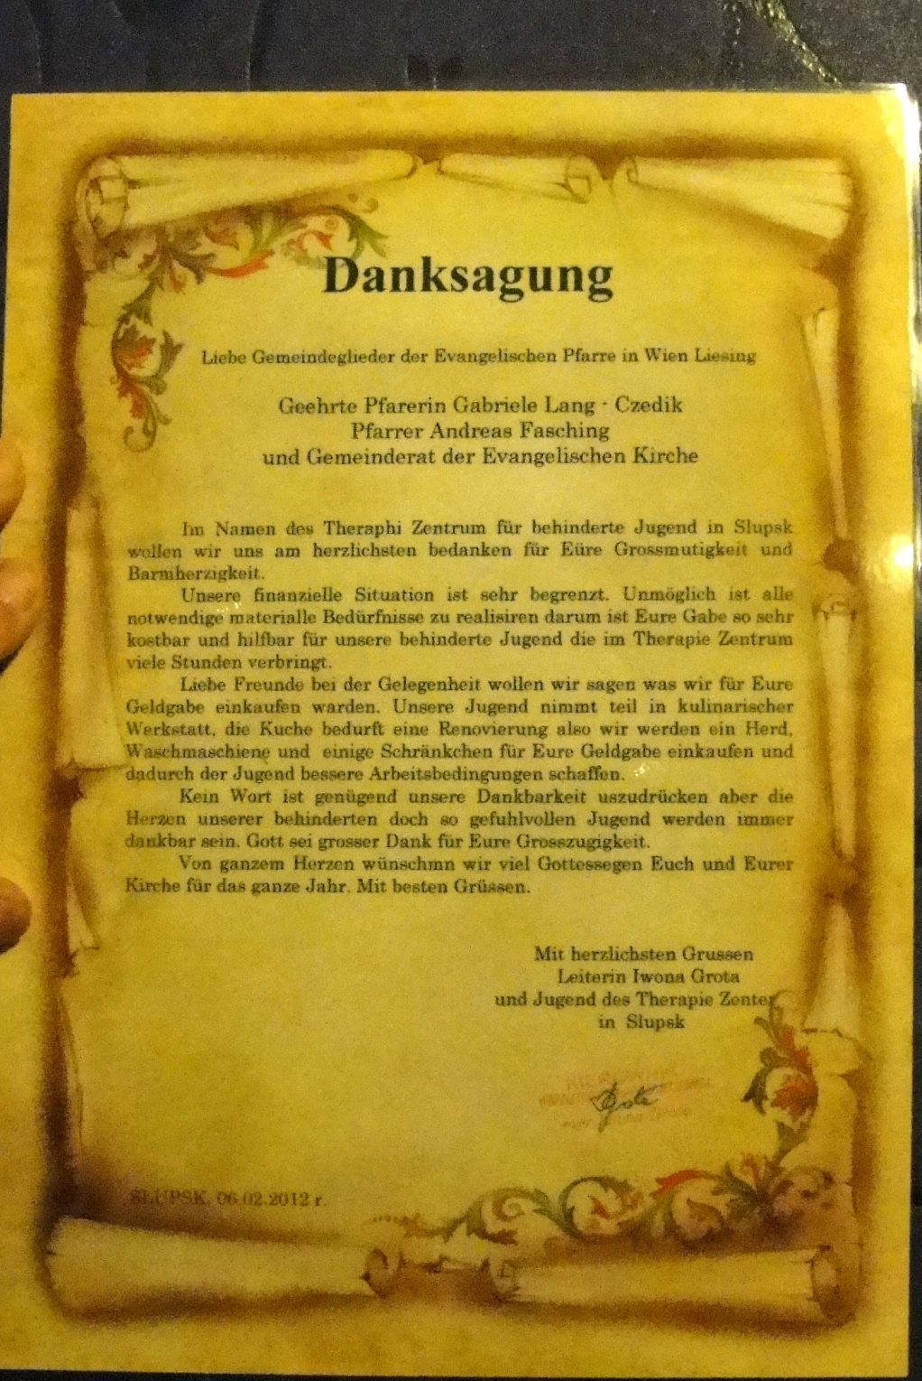
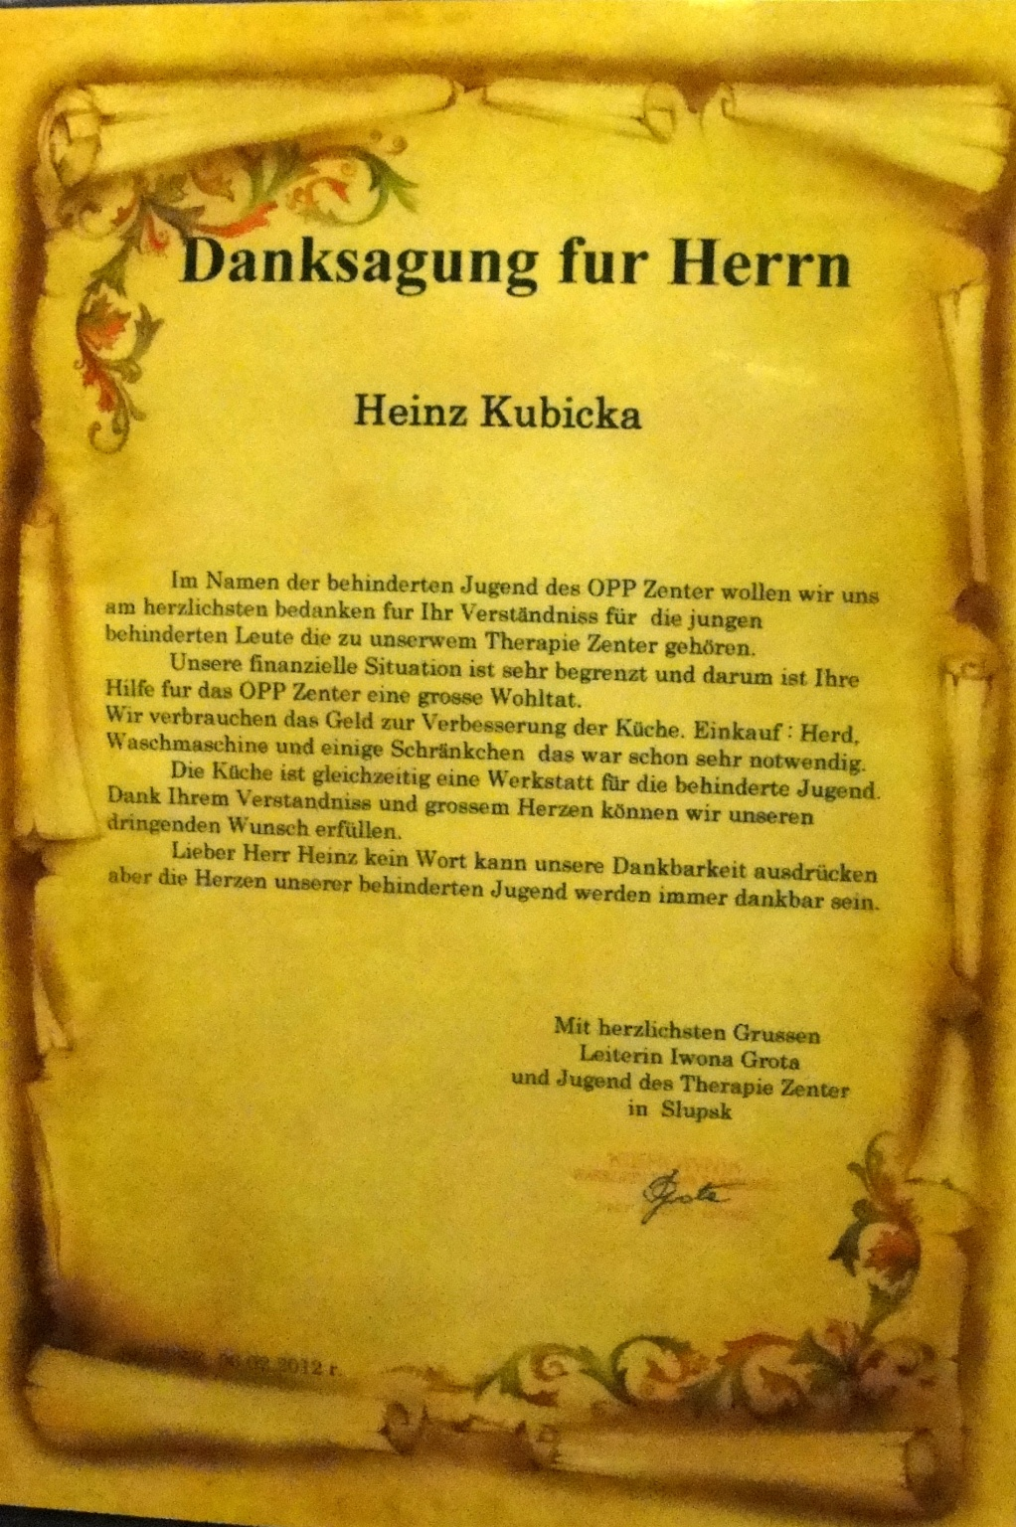

Slide 25
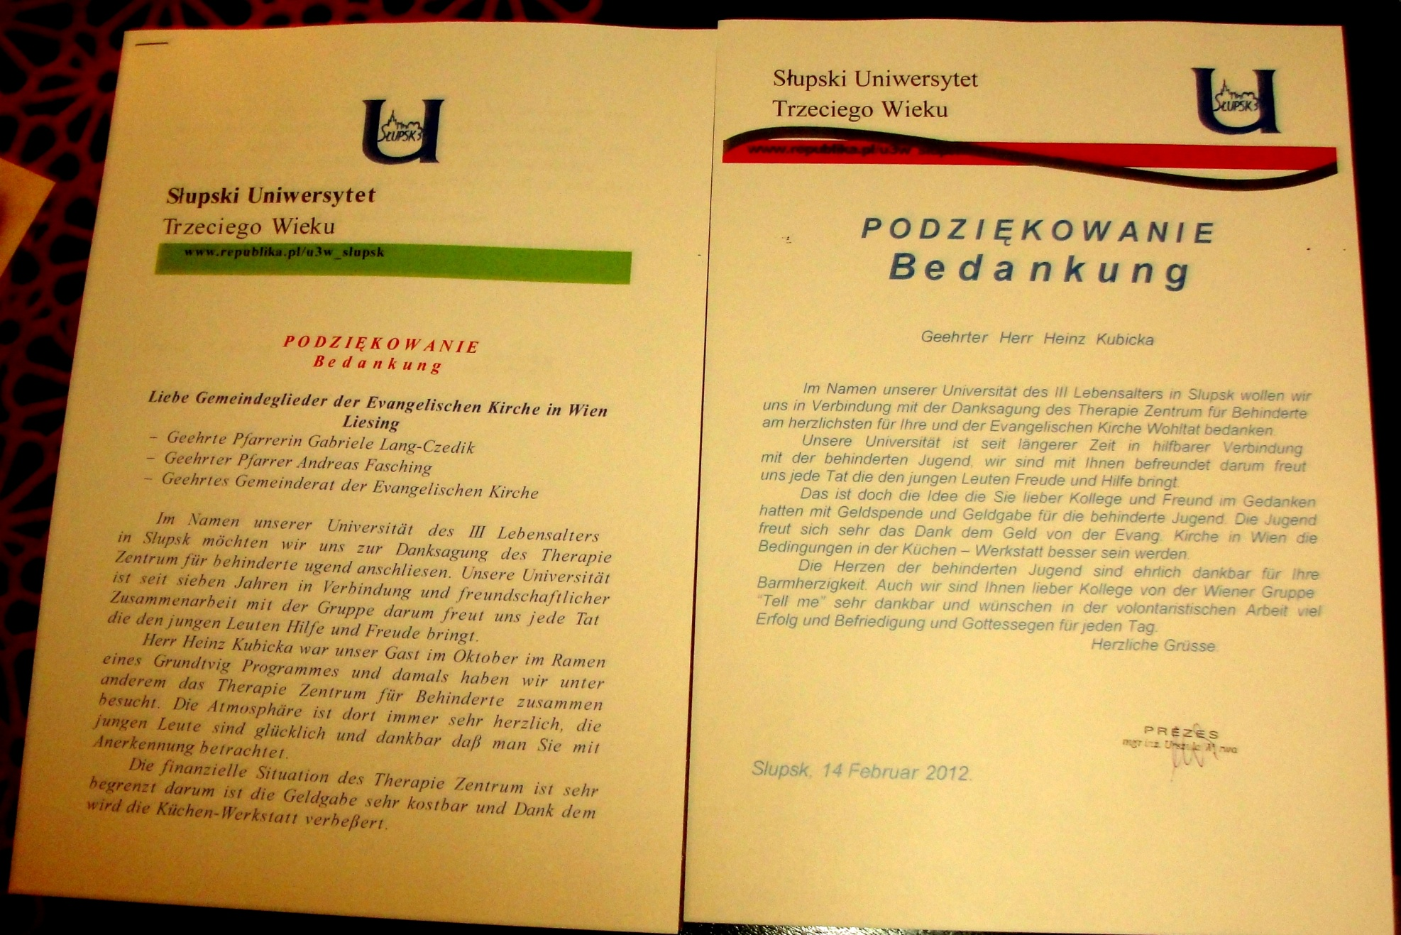

Slide 26
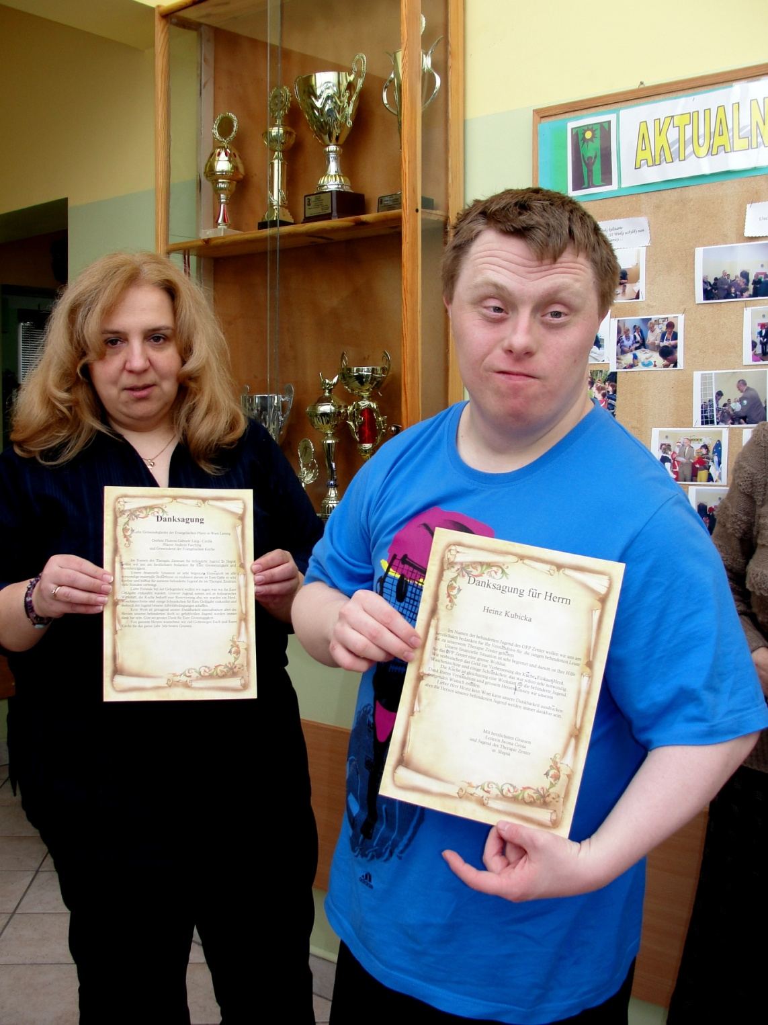
Mrs Iwona Grota and one of her patient presenting THANK YOU diploma which then was sent to Vienna.

Slide 27
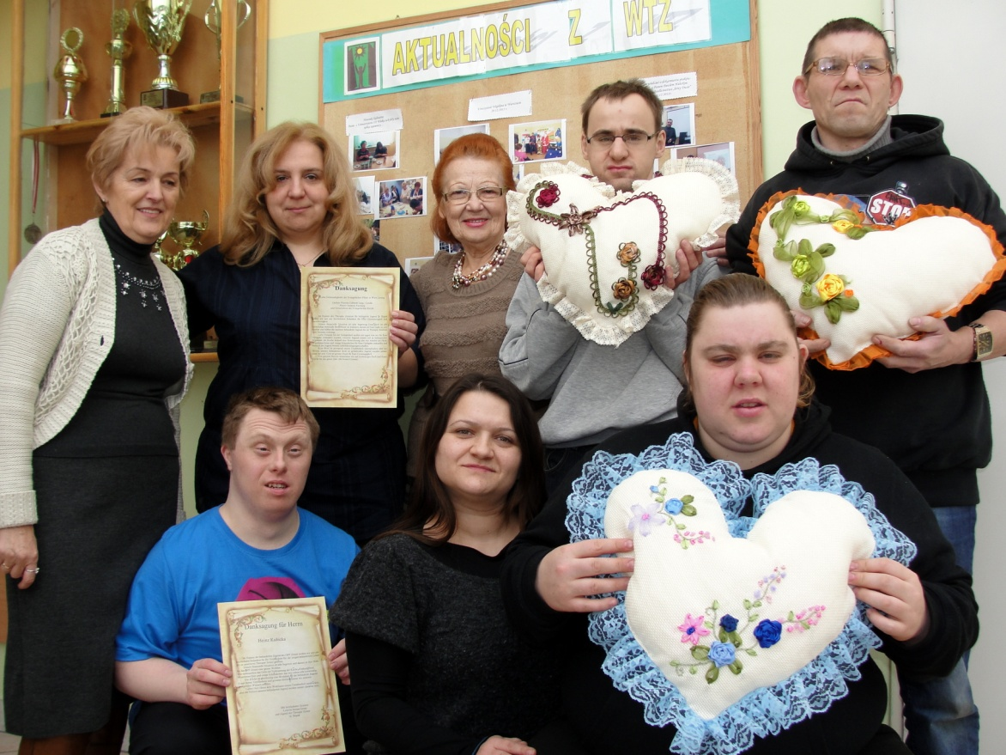

Slide 28
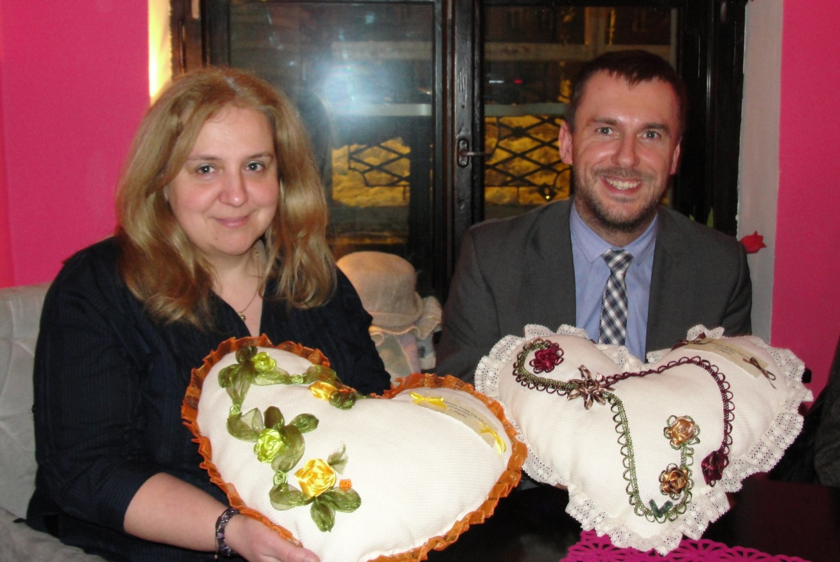
The Big Hearts for the Gift of the Heart from Mr Heinz Kubicka of Vienna.

Slide 29
Słupski Uniwersytet Trzeciego Wieku
Die Wiener Volkshochshule GmbH, Volkshochschule Alsergrund, Vienna, Austria
The Occupational Therapy Workshop In Slupsk.Poland
THANK YOU
The City of Slupsk

