Slide 1
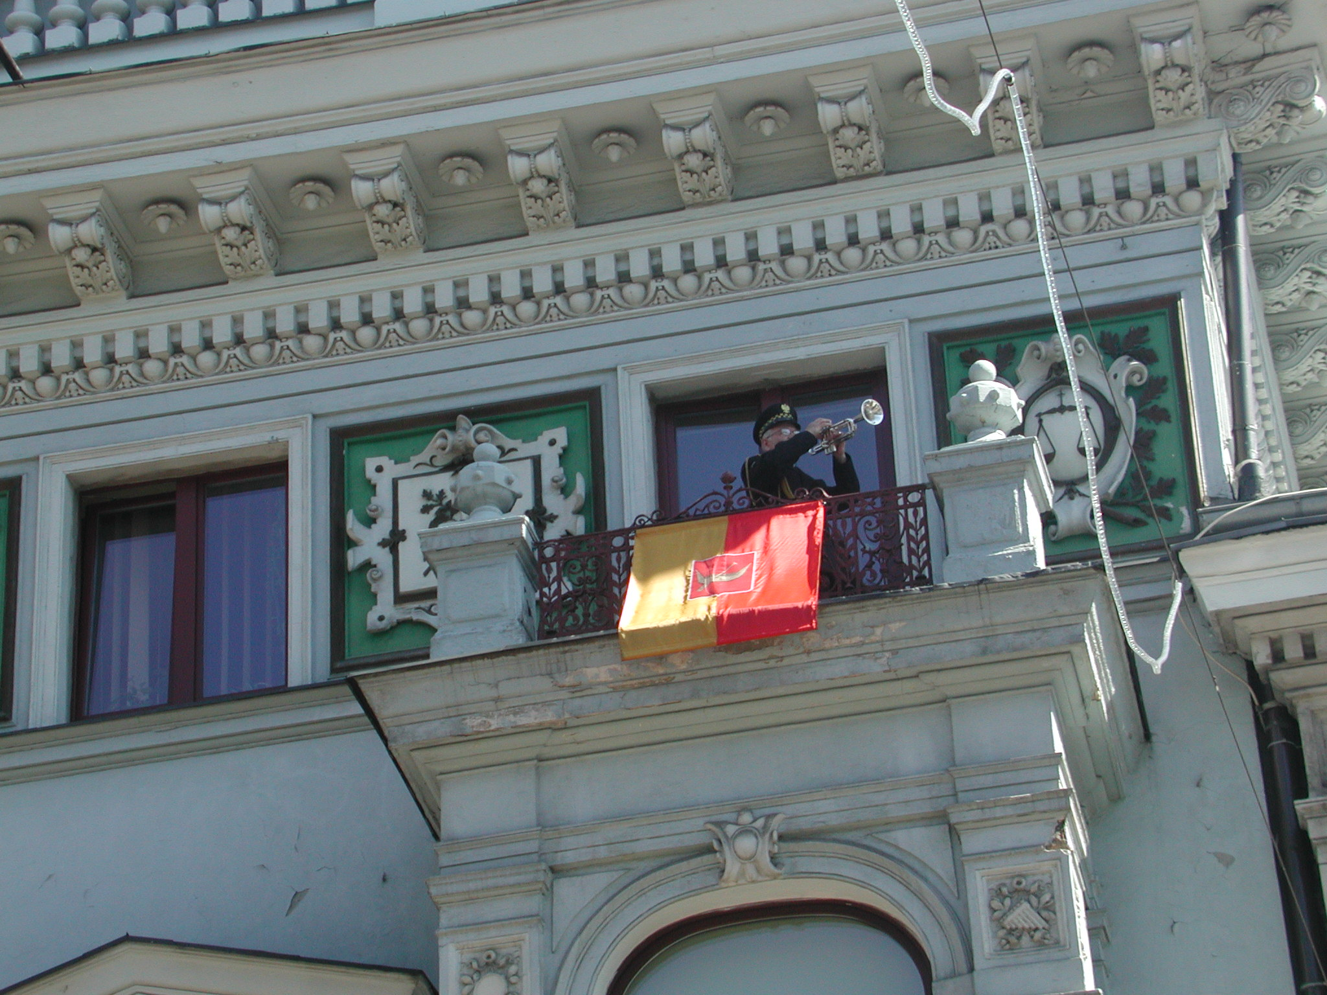


Slide 2
Where do we come from?
From Poland
and from ……….????

Slide 3


ŁÓDŹ - where is it?

Slide 4
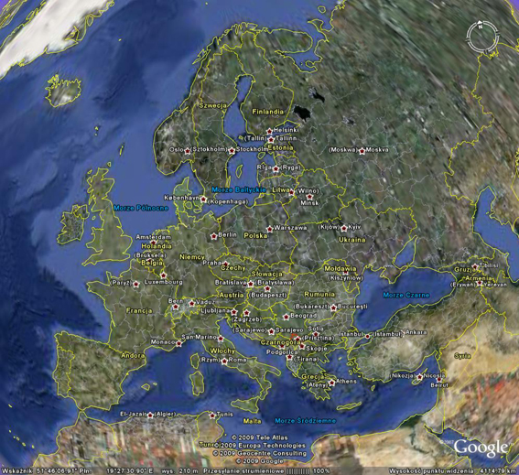

Slide 5
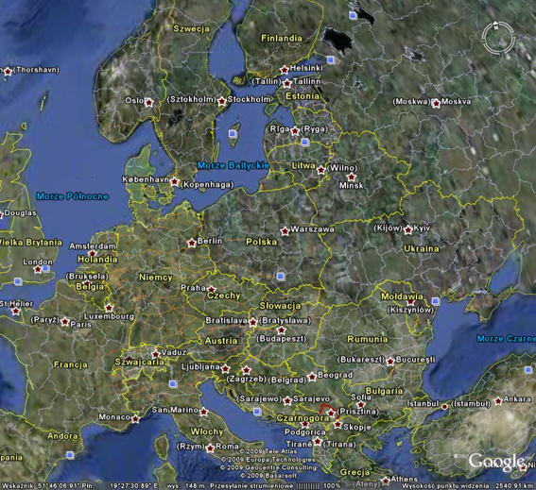

Slide 6
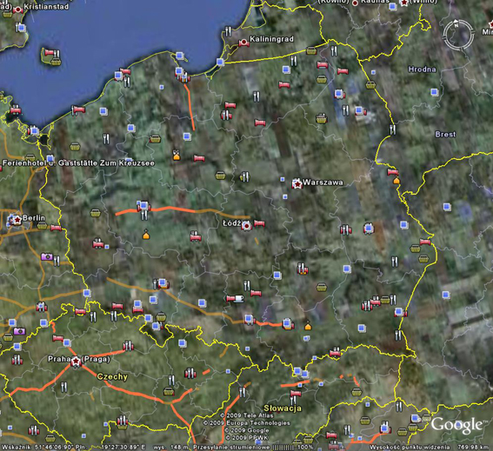

Slide 7
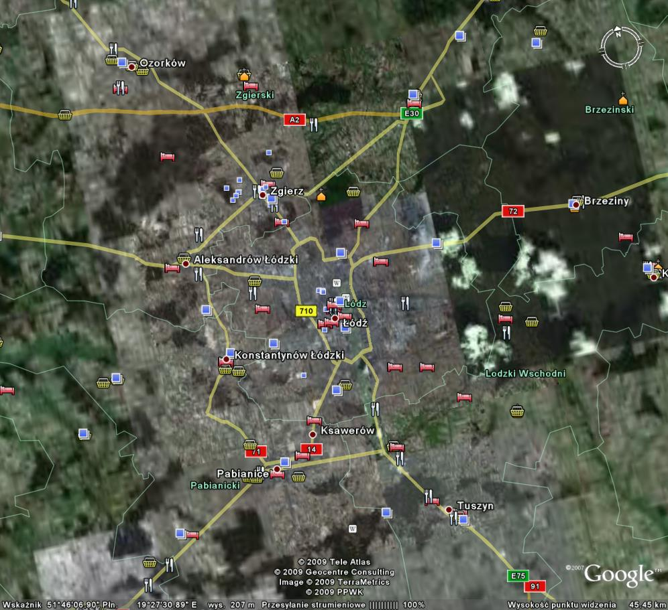
ŁÓDŹ IN THE CENTER OF EUROPE

Slide 8
A short history of ŁÓDŹ
1423 granting a town charter
1423 – 1829 agricultural ŁÓDŹ
1829 – 1989 industrial city,
population growth
1829 – 1865 a planned development
after 1865 a wild development

Slide 9
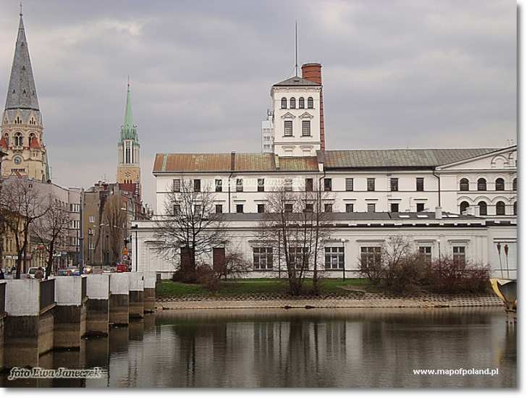

Slide 10
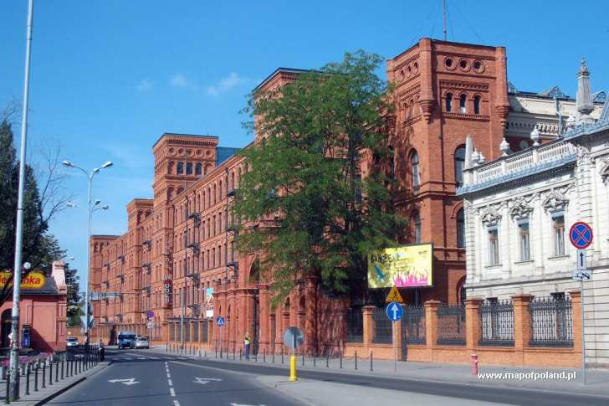

Slide 11
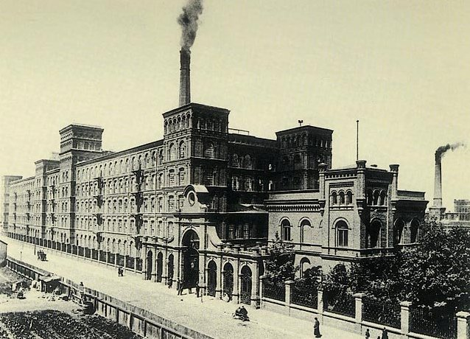
ŁÓDŹ in XIX- XX century
Important industrial center
1904
factories
70 000 workers

Slide 12
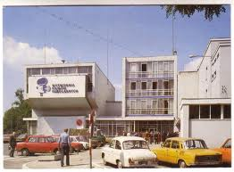
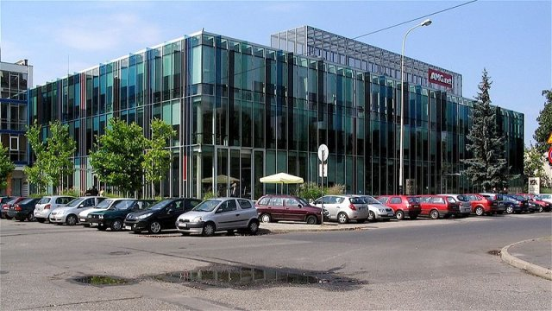
Film Center
HOLLYŁÓDŹ

Slide 13

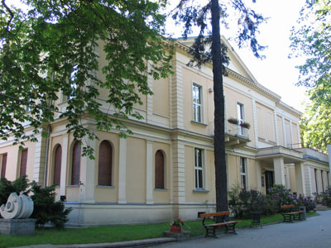
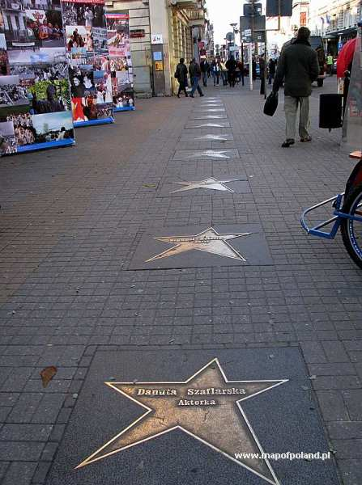

Slide 14
1989

Slide 15
1990 – 2012 a transformation of ŁÓDŹ
from workers’ city
into
academic center and culture and art city
people with higher education
In 1960 – 12 000 (1,8%)
In 2002 – 100 800 (14,6%)
In 2010 about 740 000 citizens

Slide 16
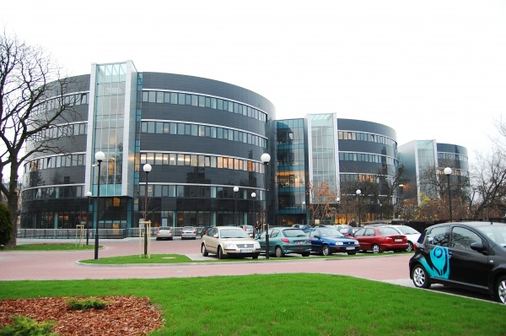

Slide 17
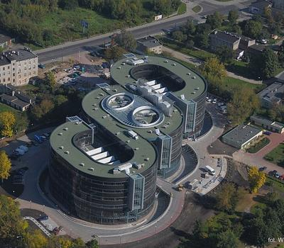
§

Slide 18
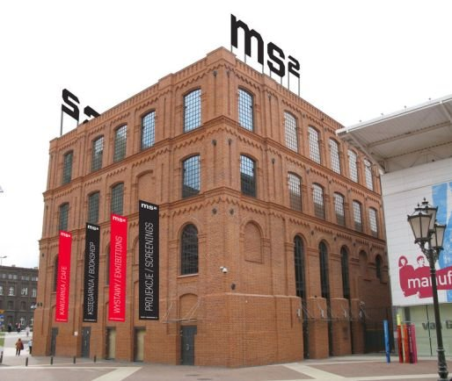

Slide 19
Academic ŁÓDŹ
Currently about 30 high schools
6 public high schools:
University of Łódź
Technical University
Medical University
Academy of Fine Arts
Academy of Music
The Polish National Film, Television and Theatre School
over 20 private high schools

Slide 20
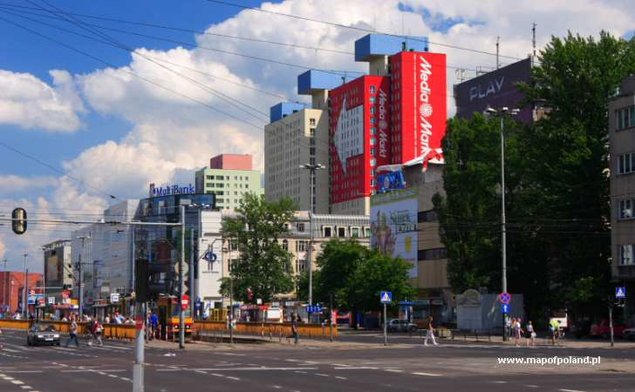
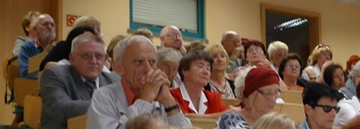
8
Universities of theThird Age

Slide 21

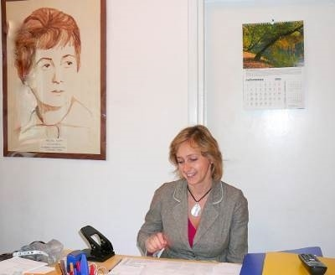
Lodzer University of the
Third Age
1979
Established in
950
Association, of about
members
NON PROFIT

Slide 22

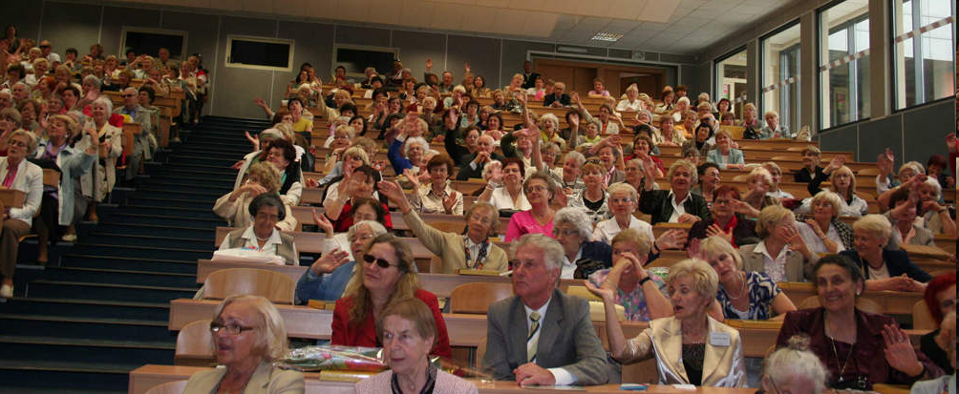
For retired people in Łódź

Slide 23
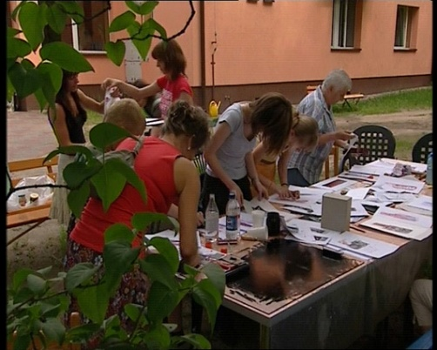
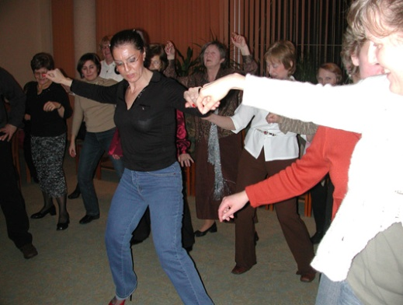
You can study as long as you want to
No marks, no student record books

Slide 24
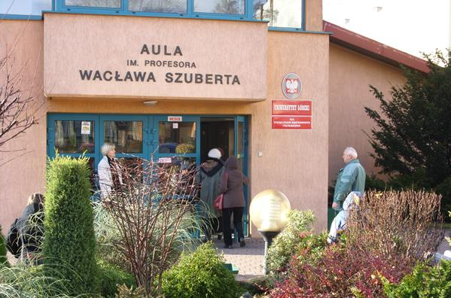
LECTURES
2 PER WEEK
IN A SEMESTER SYSTEM

Slide 25
FOREIGN LANGUAGE COURSES
English, German, French, Russian, Spanish, Italian and Japanese.
293 PEOPLE
IN
29 GROUPS

Slide 26
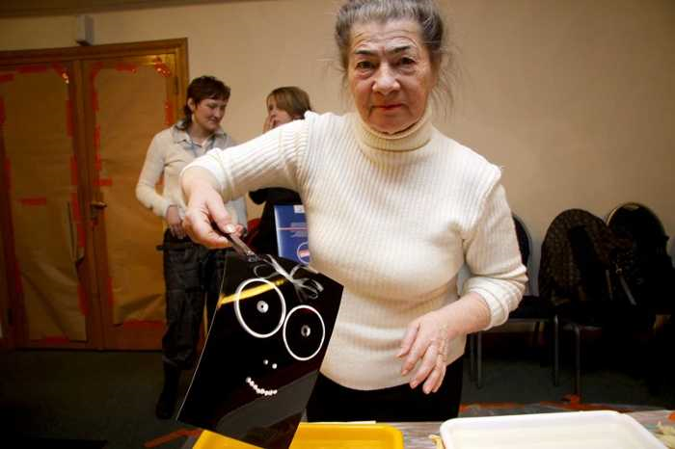
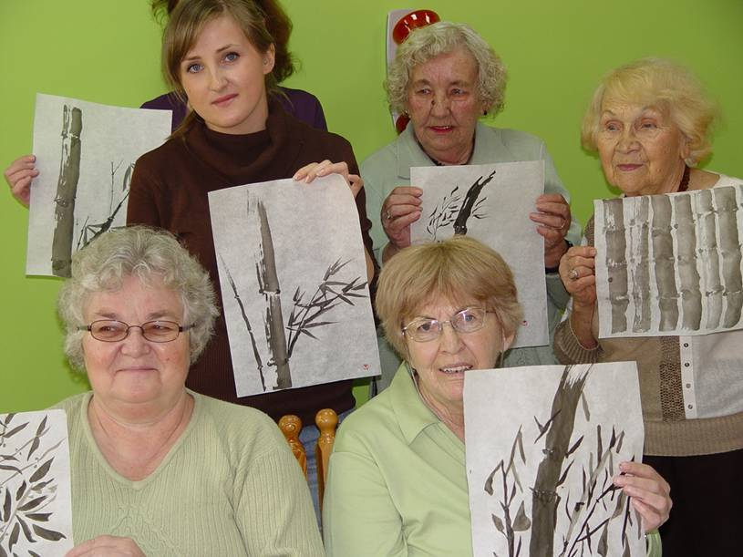
19 SECTIONS
literature, history, arts, tourism, biology and medicine, linguistics, culture, art history and museology, social science, the study of theatre, psychology, stage and chorus, Japanese language and calligraphy, Japanese culture.

Slide 27
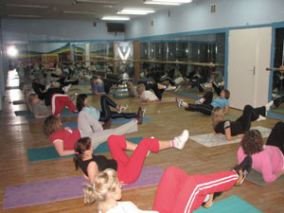
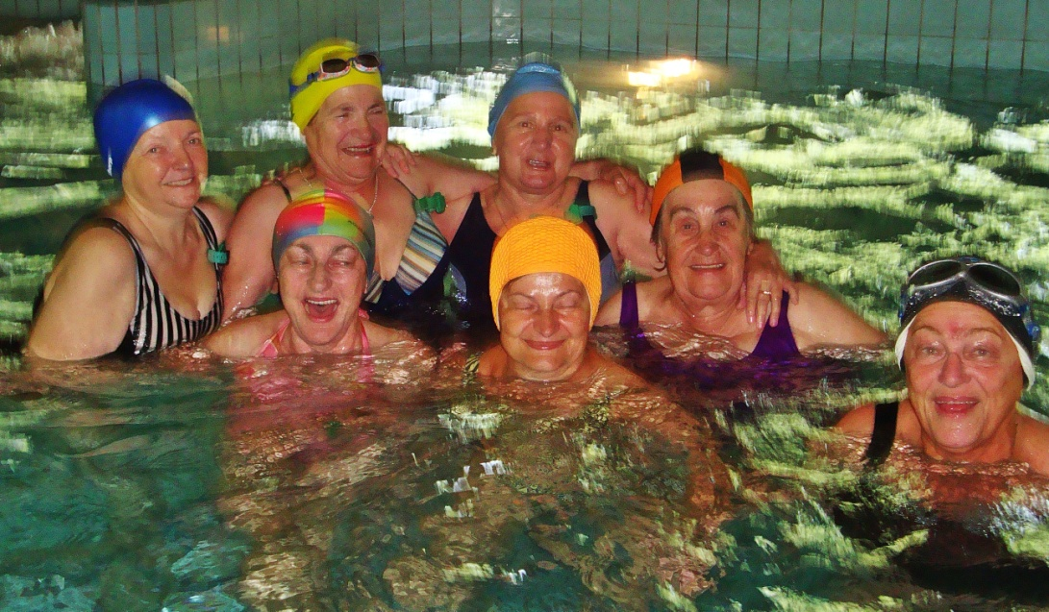
PHYSICAL ACTIVITIES
physical exercises
swimming

Slide 28
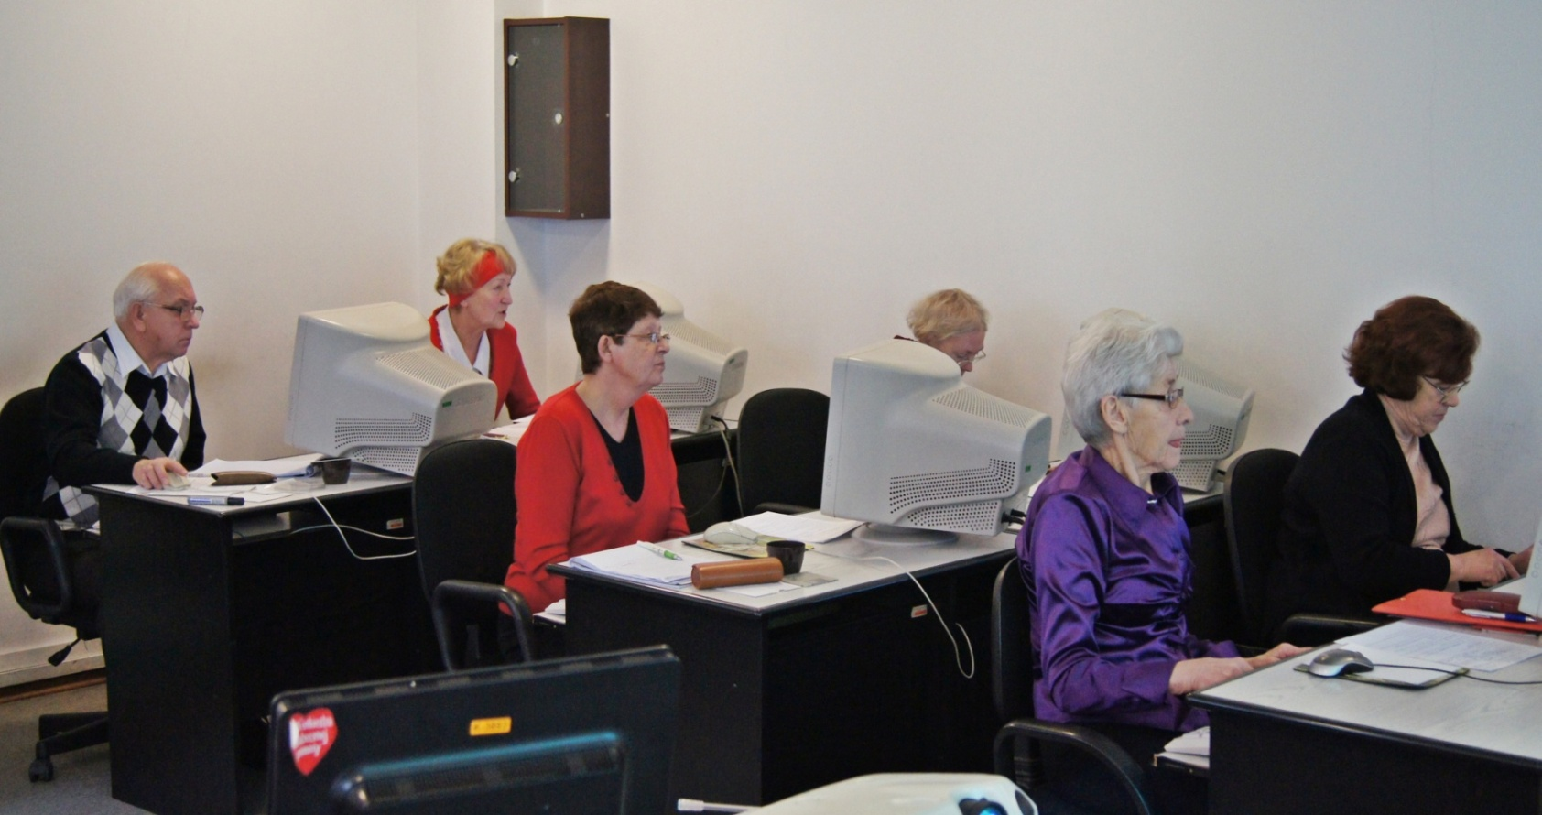
WORKSHOPS OF : computers photography ecology literary

Slide 29
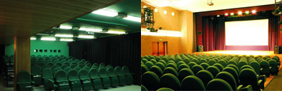
CULTURAL FIELD
inexpensive tickets
to the theatres, movies and concerts

Slide 30
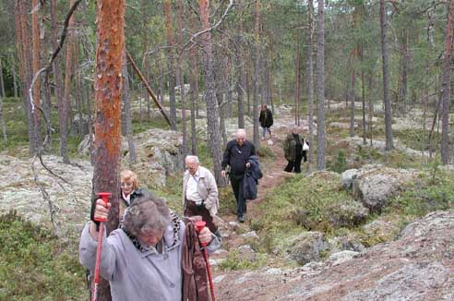
TOURISM
Our sections organise :
Oneday trips throught Łódź
Somedays trips to interesting places in Poland
Abroad trips ( cooperation with touristic agency)

Slide 31
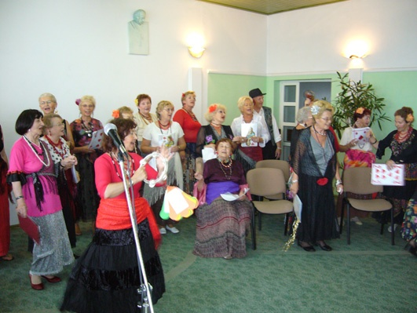
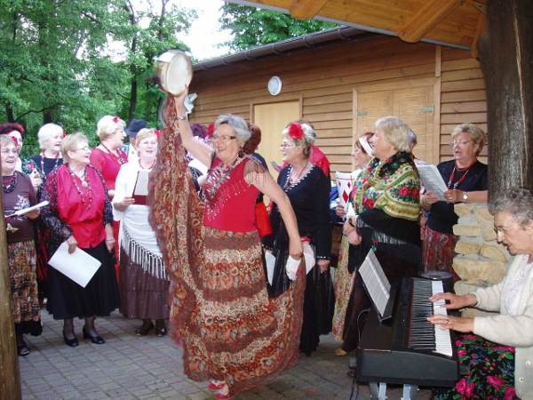
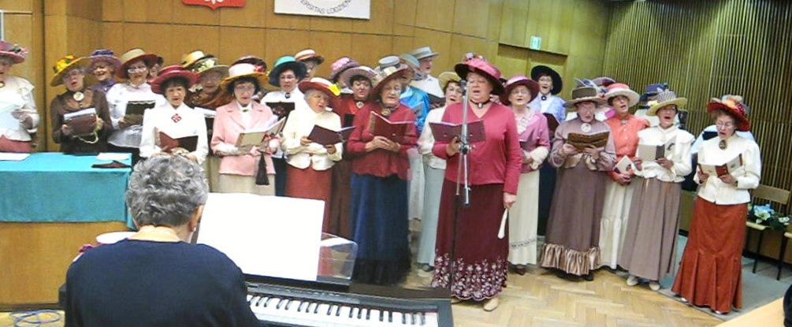
CHOIR
consists of 35-40 people.

Slide 32
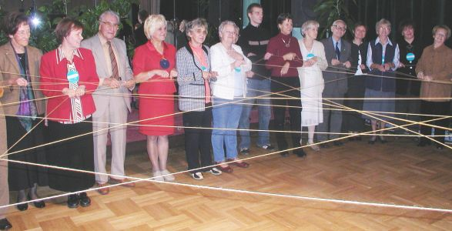
Grundtvig
PROJECTS
ODE (2004-2006)
(Open Door for Europe)
Let’s Go for IT (2005-2007)
SENIOR (2008-2010)
(Support European Neighbours In Open Relations)
TAPE (2008-2010)
(Trans-generational Arts/cultural Platform in Education)
TOYS of My Parents (2010-2012)
Express & Connect (2010-2012)

Slide 33







WE EDIT „BIULETYN”
TWICE A YEAR
And occasional publications:
Album of paintings by LUTA's students
Stories and poems written by LUTA's students
Fascinations of professors and students
Roles and tasks of elderly people in local community

Slide 34
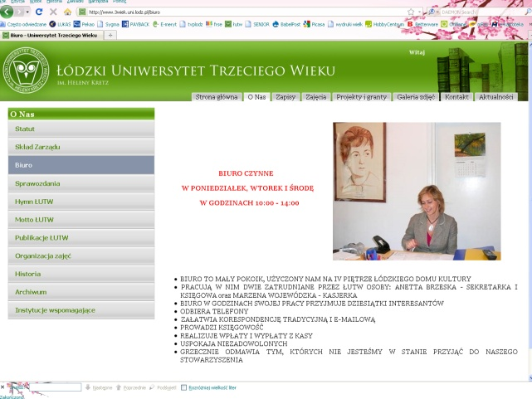
WE HAVE GOT
the anthem
the logo
the website
www.3wiek.uni.lodz.pl

Slide 35
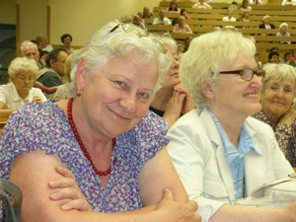





MOTTO
Nie ma na starość lepszego leku
Niż Uniwersytet Trzeciego Wieku
Es gibt keine bessere Arznei im späteren Alter
Als die Universität des Dritten Lebensalters
Si a viejo no quieres nunca llegar
Ven a la Universidad de la Tercera Edad
Non emai troppo tardi per ricuperare cio che hai perduto
Vieni all`Universita della terza Eta
A saprai guello che non hai mai saputo
Es gibt keine bessere Arznei im späteren Alter
Als die Universität des Dritten Lebensalters

Slide 36

There is no better medicine for old age
Than the University of the Third Age

